Slide 1
Sviluppo e ciclo vitale di software di intelligenza artificiale
Teacher: Federico Cunico, PhD
Coordinator: Prof. Marco Cristani

Slide 2



Federico Cunico, PhD
PhD: Computer Science and Artificial Intelligence
MSc: Computer Engineering and Computer Vision
Mainly working in HRI and CV, with focus in industrial applications.

Slide 3
Course Pre-requirements
Command line interaction (linux Bash);
Python basic knowledge;
Programming language operators (if/else, for loop, while, etc...)
Scripting concepts (execution of scripts, etc...)
Machine Learning and Deep Learning basics are useful but not strictly required;

Slide 4
Course goals
Consider a “problem to solve” using ML;
Ideally you would want to:
Investigate the problem
Find a good ML model
Deploy the model
Question: how you are supposed to deploy in a non-naïve way?
Question: how to upgrade/monitor your model?

Slide 5
Course Program
Day 1
Version Control Systems (Git);
DevOps vs MLOps;
Day 2
Data Science basics; EDA; Data preparation;
Model selection and training; Hugging faces models;
Hyperparameter tuning; Grid search;
Day 3:
Docker: basics, training and deployment;
Logging and monitoring;
Day 4:
Python packaging;
AutoML;

Slide 6
Course evaluation
Implementing a small project using the concepts of:
Python DevOps (git, lint, unit tests);
Training and testing of a small ML model;
Web interface (Gradio);
Dockerization;
Github actions for CI/CD;
Monitoring and logging;

Slide 7
Version Control Systems

Slide 8


Source control
Suppose to develop a project and you want to make a change without breaking anything...
You could copy the project directory & files…
Project
main.py
Project_1
train.py
Project_2
eda.py

Slide 9
Source control
And then try to do some mix and merge….
… and find yourself with a real mess

Slide 10
Version Control Systems (VCS)
Version Control Systems solves this problem allowing you to:
Restore your project to a previous version
Check out a specific version of a file
Recover deleted files
Collaborate with other people with ease

Slide 11






Git
Git is a VCS, one of the most famous (not the only one)
Bazaar

Slide 12
Repository
A repository is kind of an archive of all the changes made to the files of your project.
A git repository is just any folder we initialize with the command
This will tell git to use the folder as repository, and create a special folder: .git
This hidden folder contains all files needed from git to run (do not delete)
git init

Slide 13
Commit
A commit is a change you made to your code.
In an ideal form it should be a single change, even if small, non correlated to other modifications.
In practice, we group together similar changes.
See this as a snapshot of the project with metadata
Author
Date
Message/Comment
Hashes (current and previous commit)

Slide 14
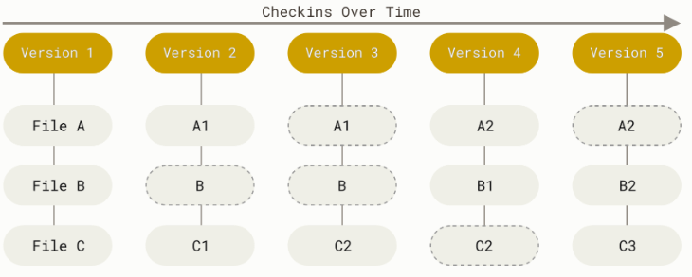
Commit
Image from: https://git-scm.com/book/en/v2/Getting-Started-What-is-Git

Slide 15
Commit
Commit after commit creates a chain of commits, that is the history of the repository just like a linked list
Commit 1
Commit 2
Commit 3
Commit 4

Slide 16
Staging area
Before making a commit, you need to tell git what should be included.
The staging area is a virtual container where we can add changes.
Note: creating a new file IS a change to the project

Slide 17
Git ignore
Very important to ignore files larger than a few MB (over 100MB requires a special file system called GLFS, which is expensive)
Rule of thumb: you don’t want to put on git single files larger than 5-10 MB.
This applies for model checkpoints, datasets, zips, etc…

Slide 18
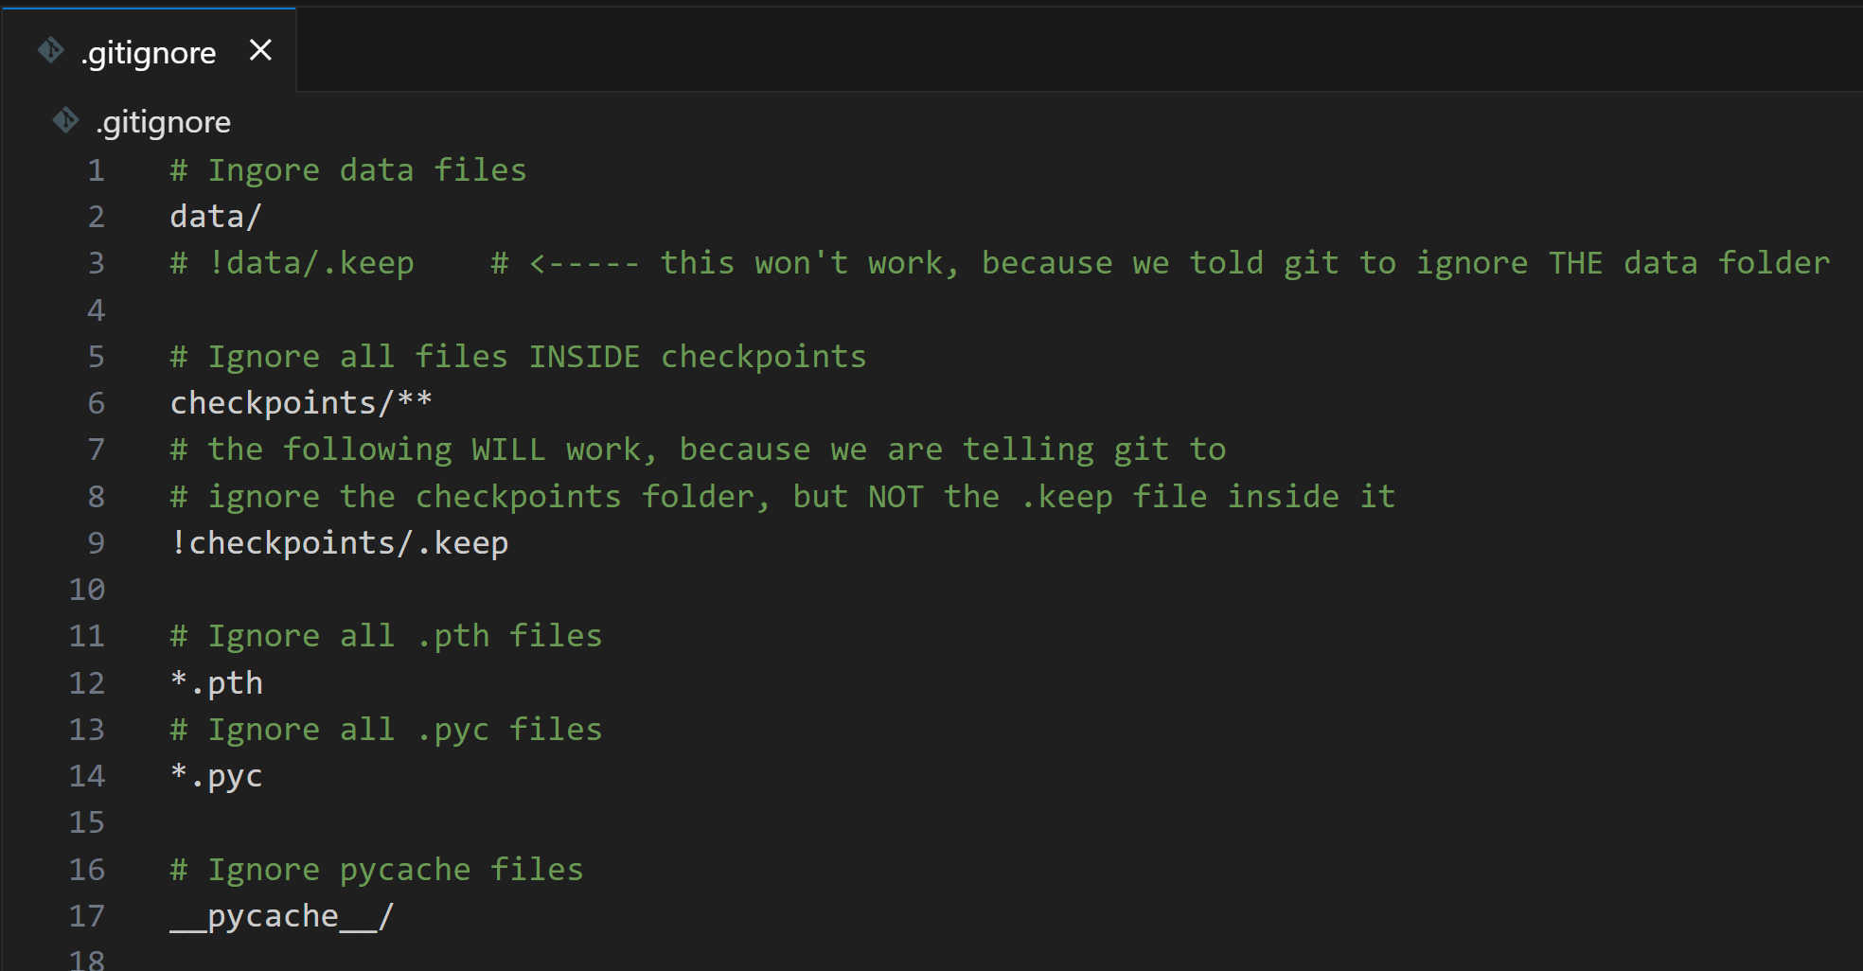
Git ignore

Slide 19

Git CLI vs IDE
Git can be used through CLI and often is integrated in IDEs
I’ll guide you quickly towards the Visual Studio code IDE*
This is not a course on Git so I will show you the basics to work with
* strictly speaking, VSCode is not an IDE, it’s a text editor. Extensions enables the IDEs features

Slide 20
Install requirements
Python
VSCode
Git
VSCode Python Extension

Slide 21
Install requirements
Python
VSCode
Git
VSCode Python Extension

Slide 22
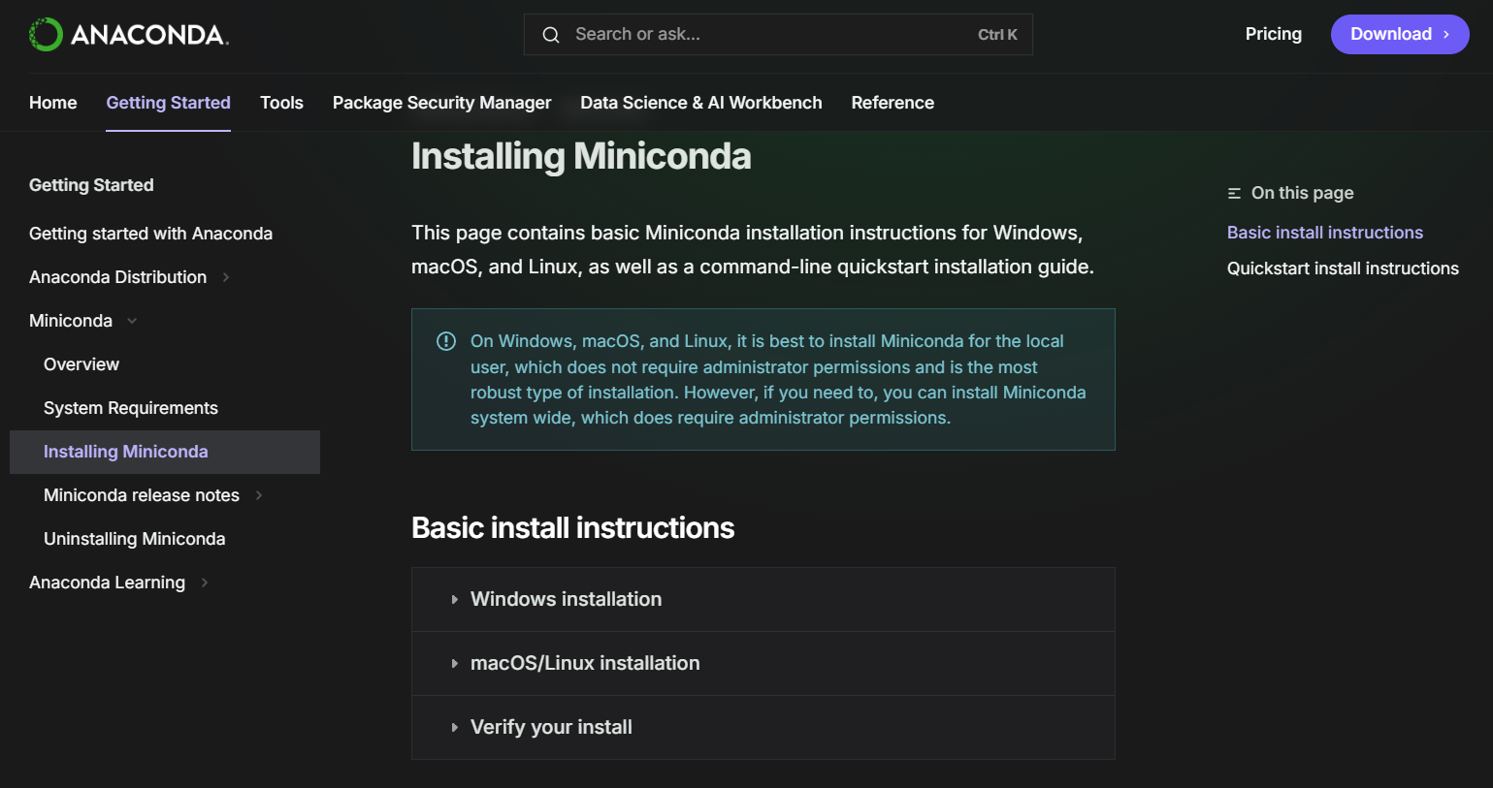
Miniconda (optional)
https://www.anaconda.com/docs/getting-started/miniconda/install
Virtual envs manager
Useful to download a specific version of python interpreter
Different projects may have different interpreter versions
I suggest you miniconda and not Anaconda

Slide 23
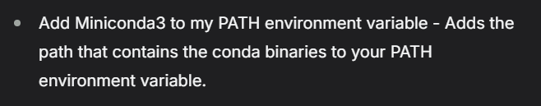
Miniconda (optional)
Say yes to add to environment variables (PATH).
Otherwise, you need to use the anaconda prompt or manually add it to the PATH.
If you stick with system Python installation it’s not a problem for this demo;

Slide 24
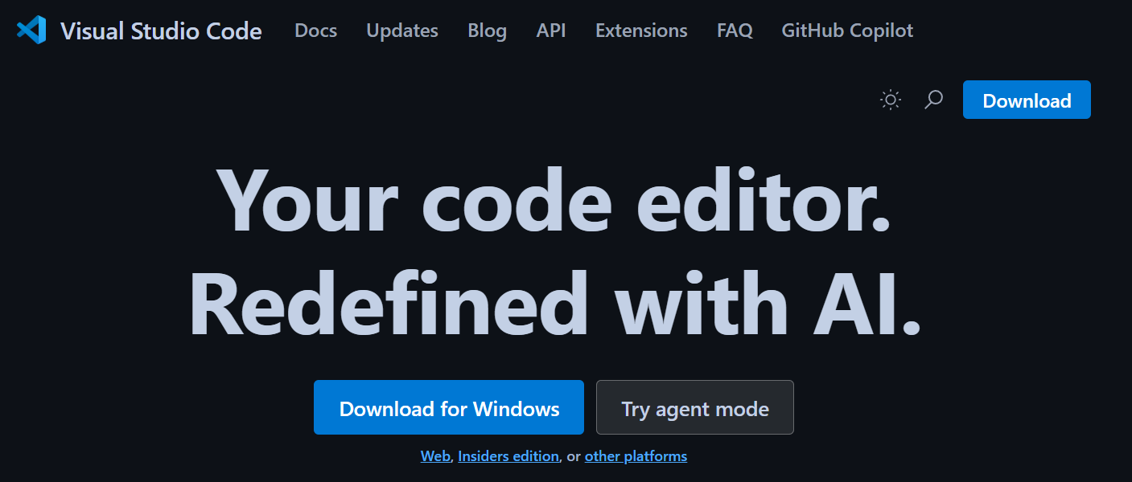
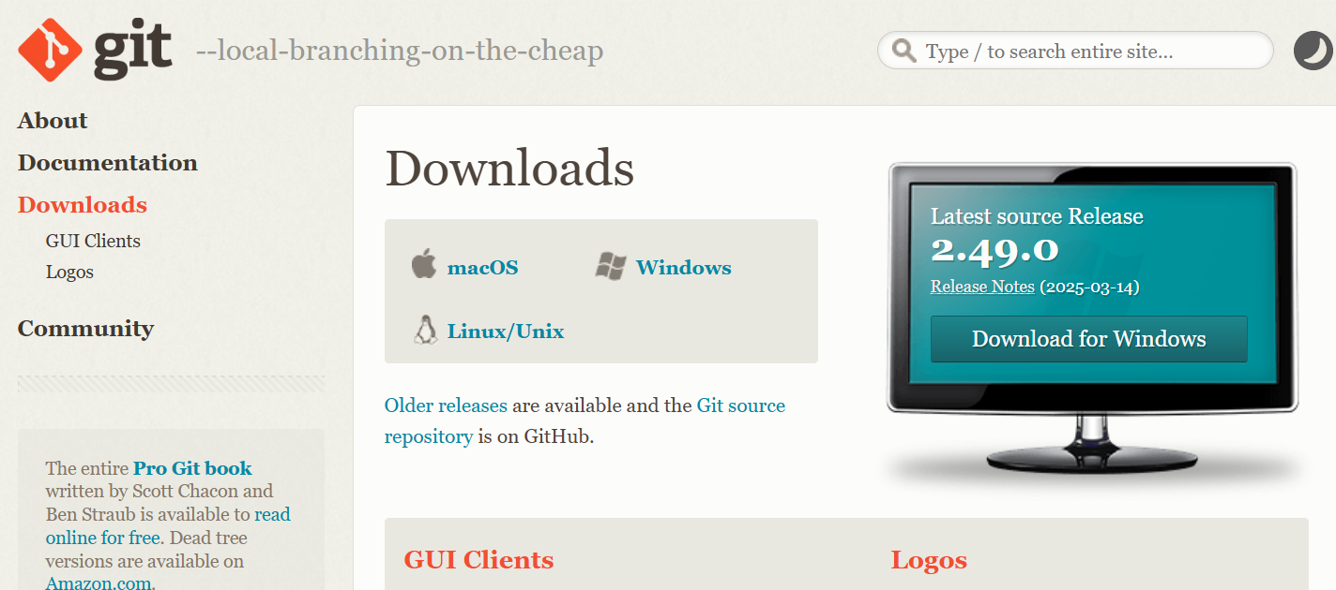
Install requirements
https://code.visualstudio.com/
Python
VSCode
Git
VSCode Python Extension
https://git-scm.com/downloads

Slide 25
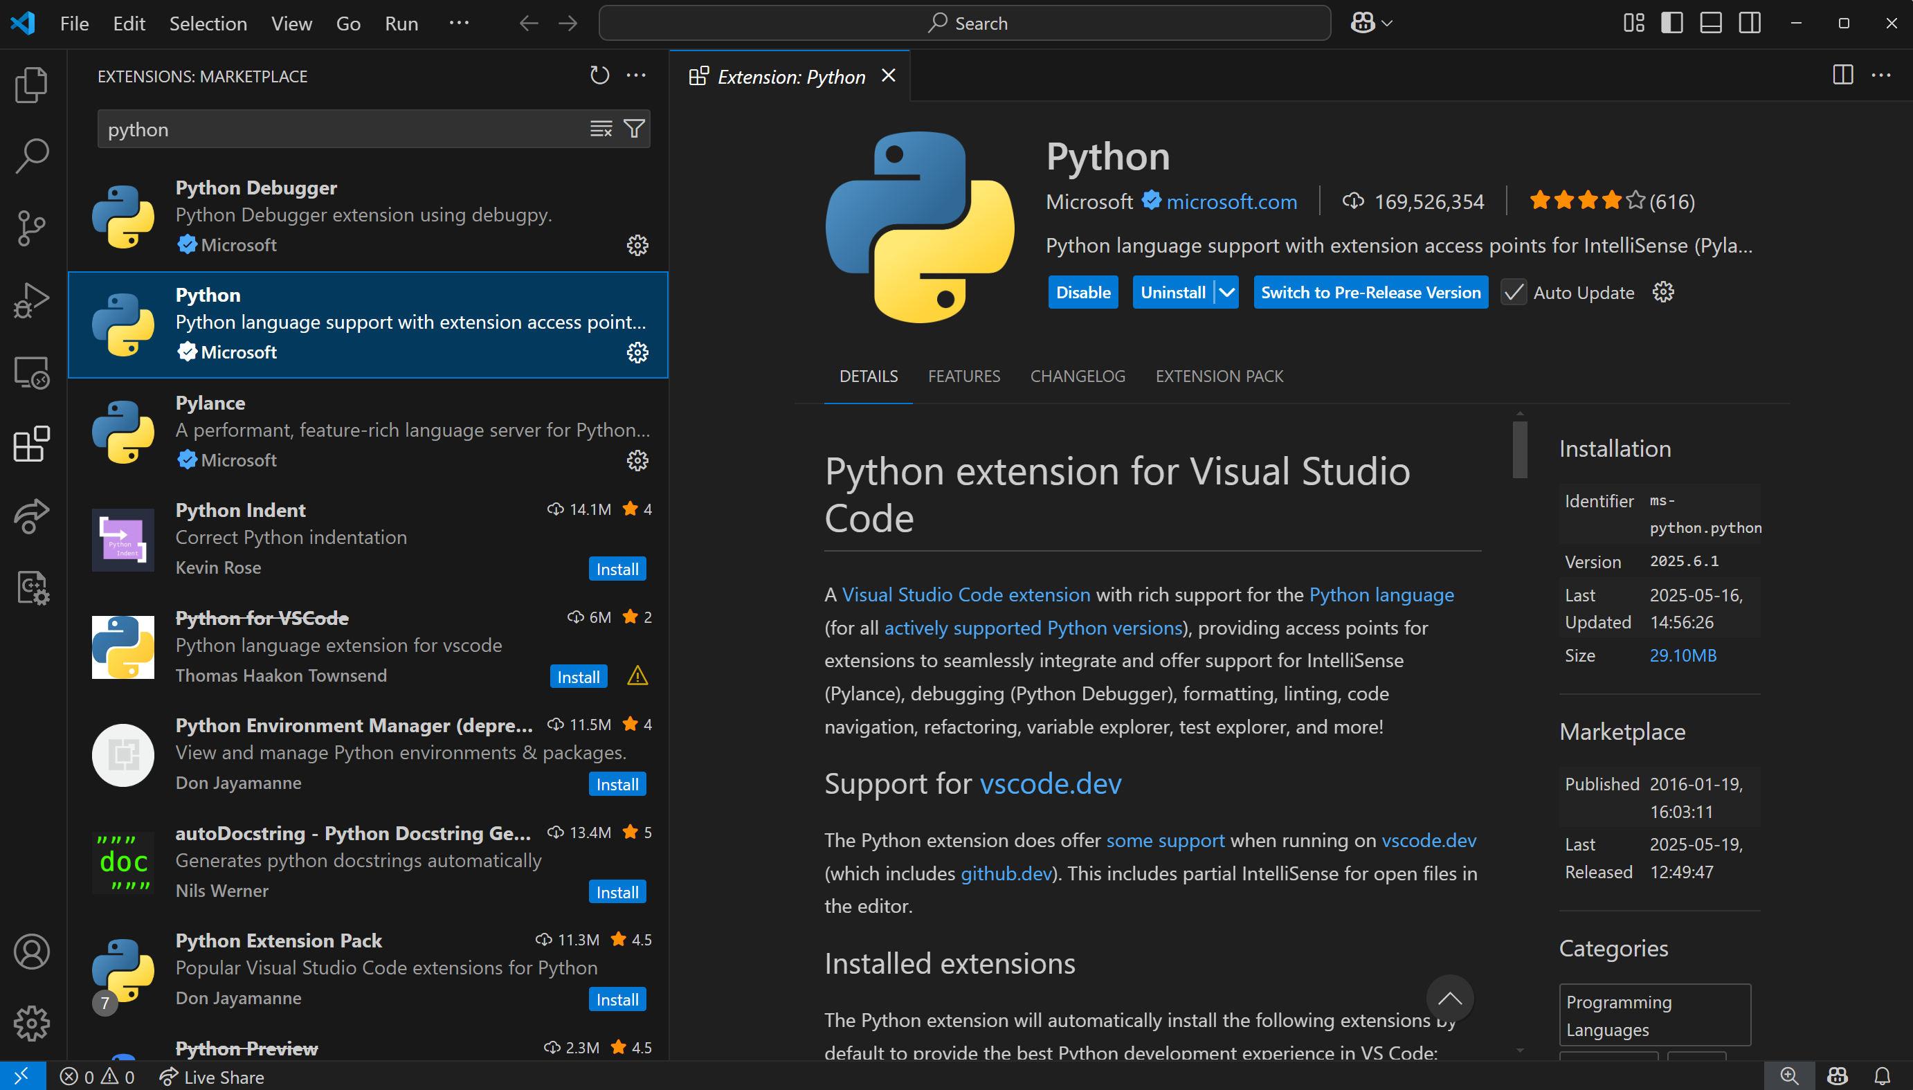
We will get back on this later

Slide 26
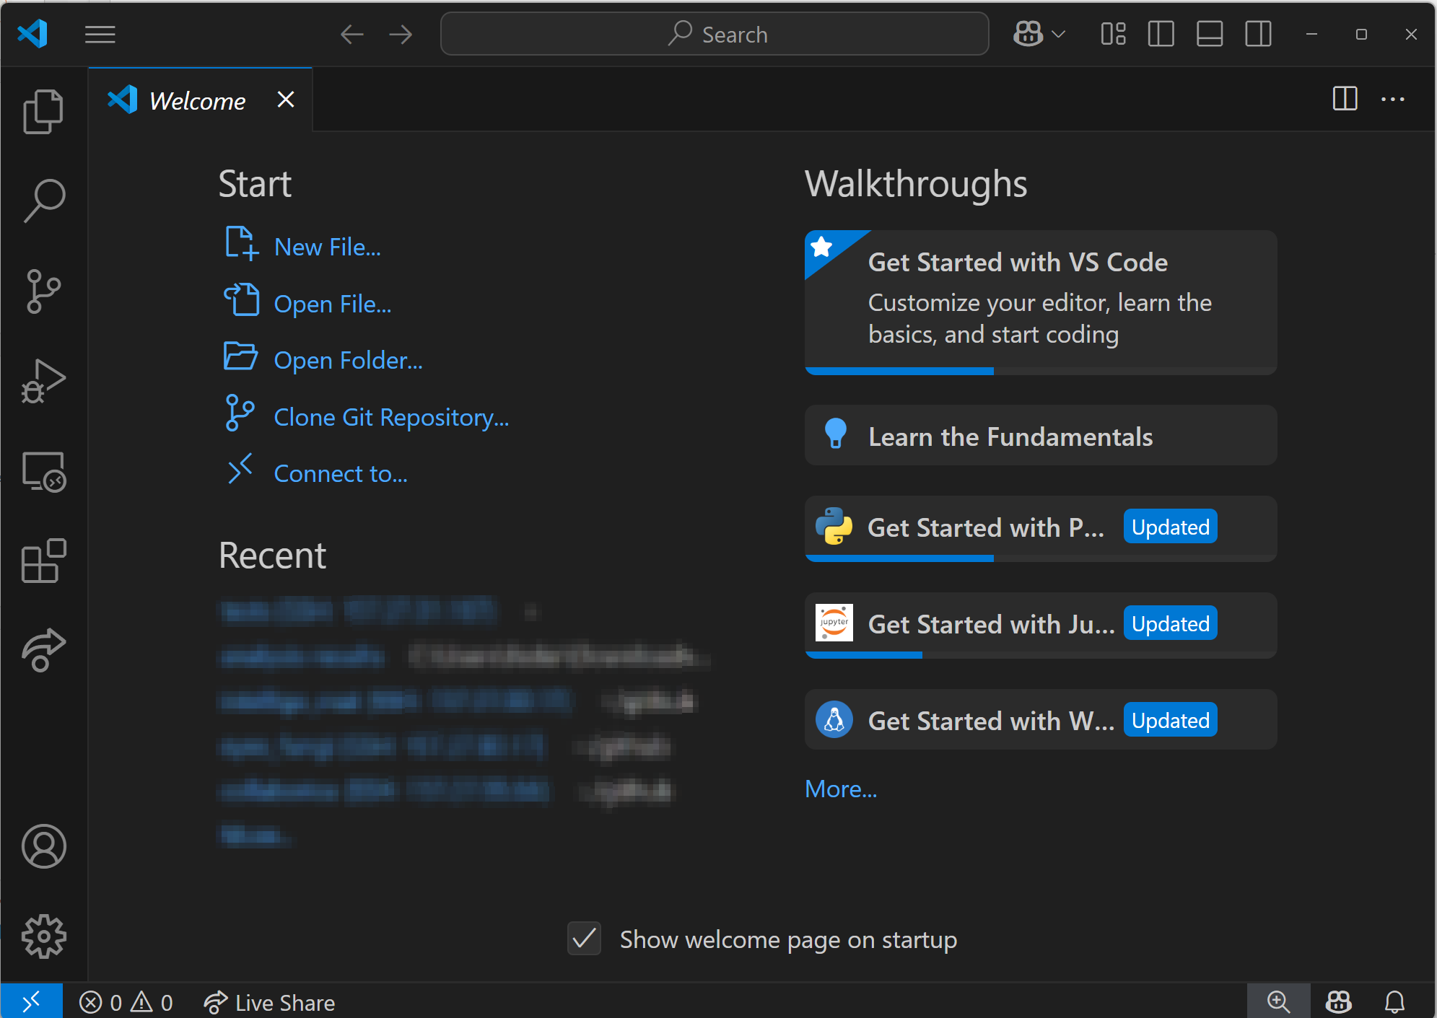
VSCode + Git

Slide 27
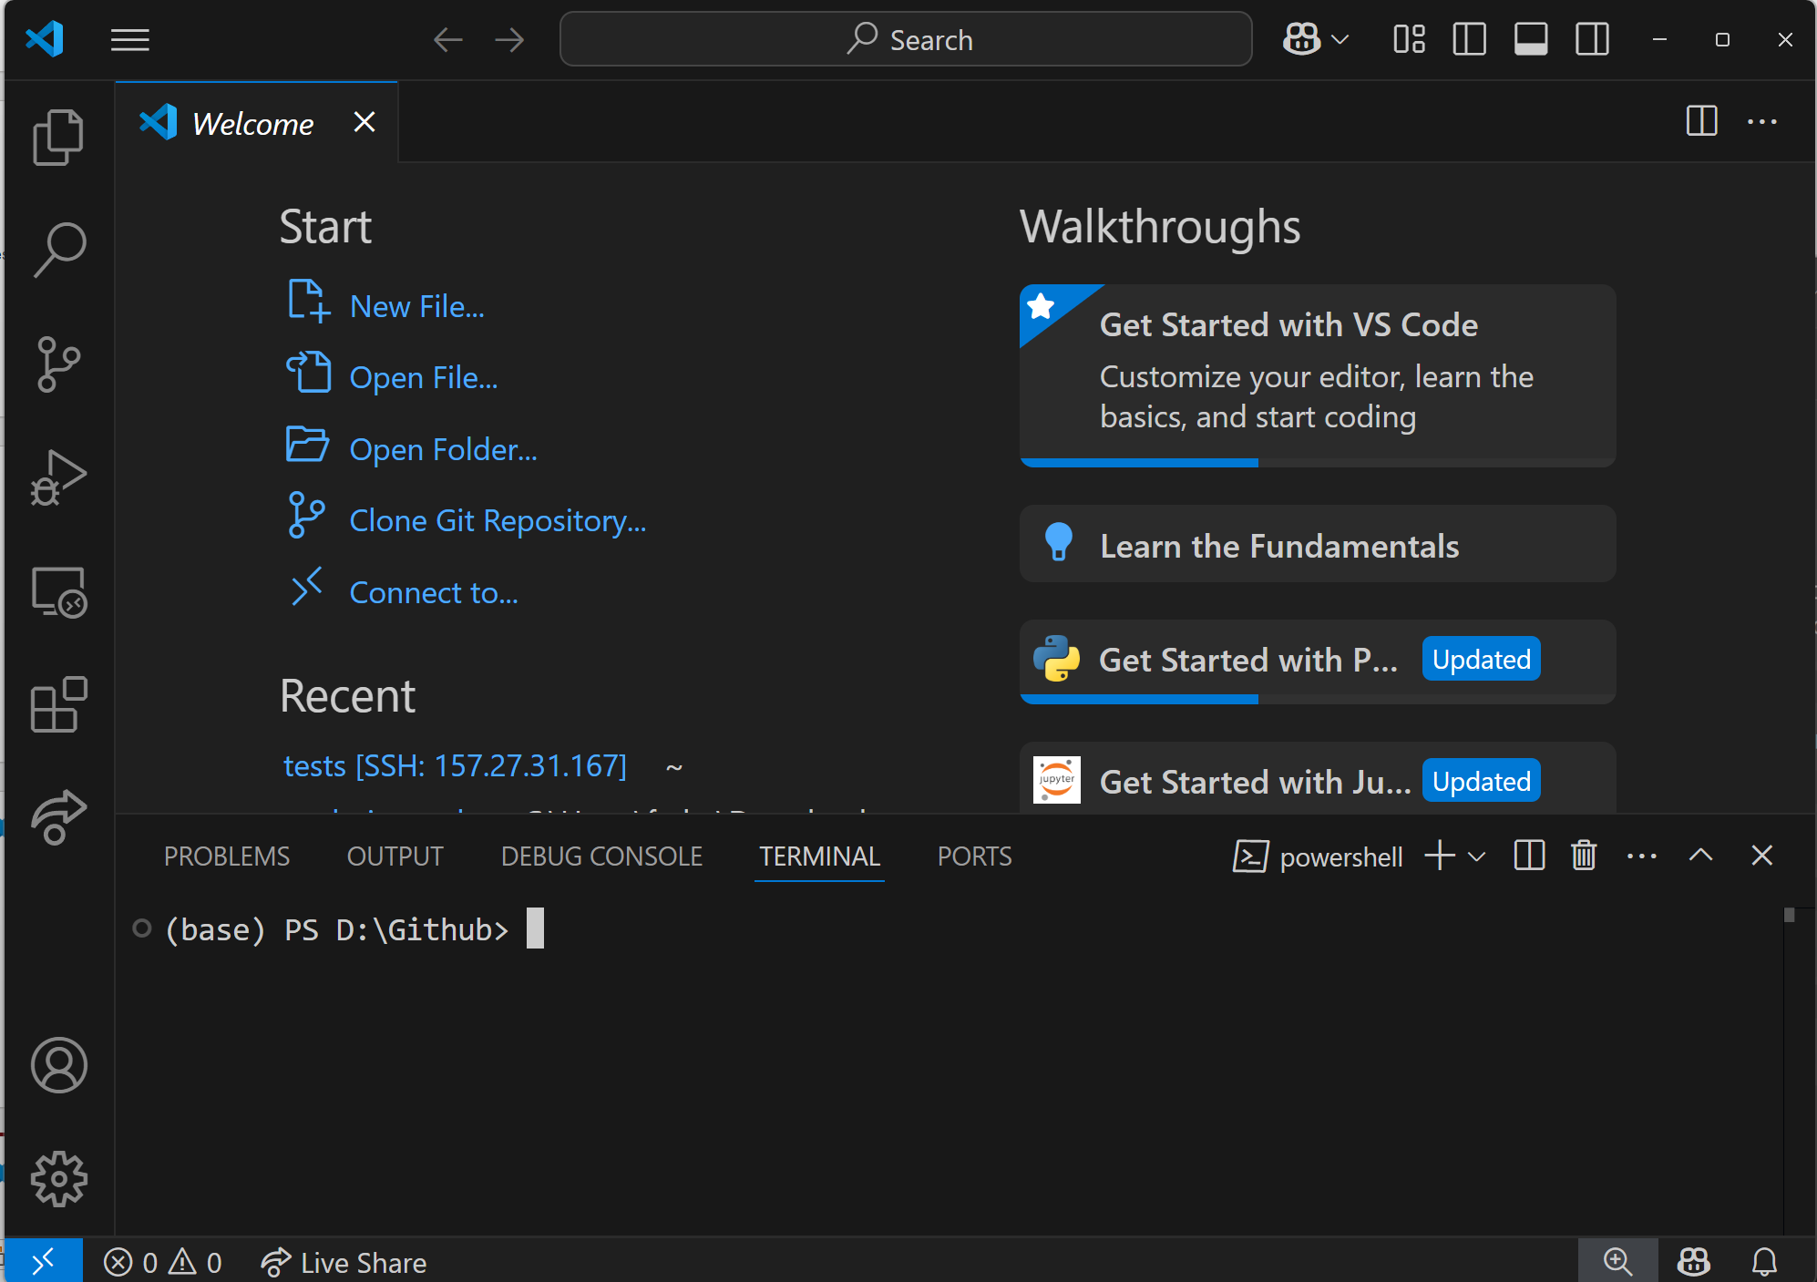
VSCode + Git
CTRL+J

Slide 28
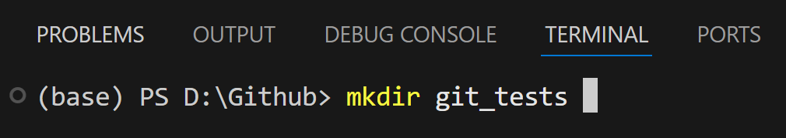
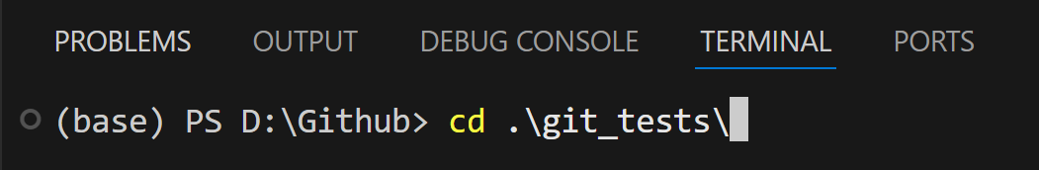
VSCode + Git

Slide 29
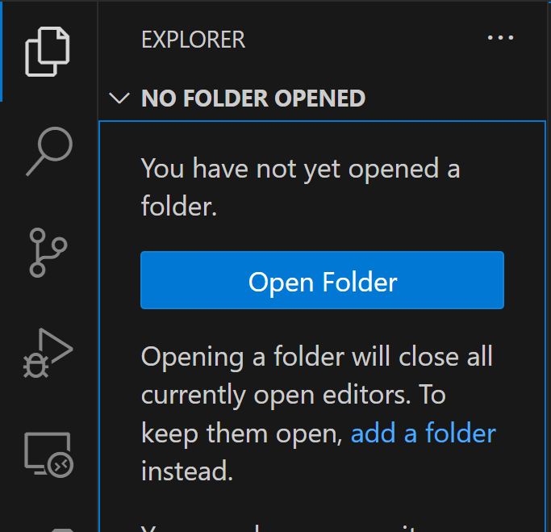
VSCode + Git

Slide 30
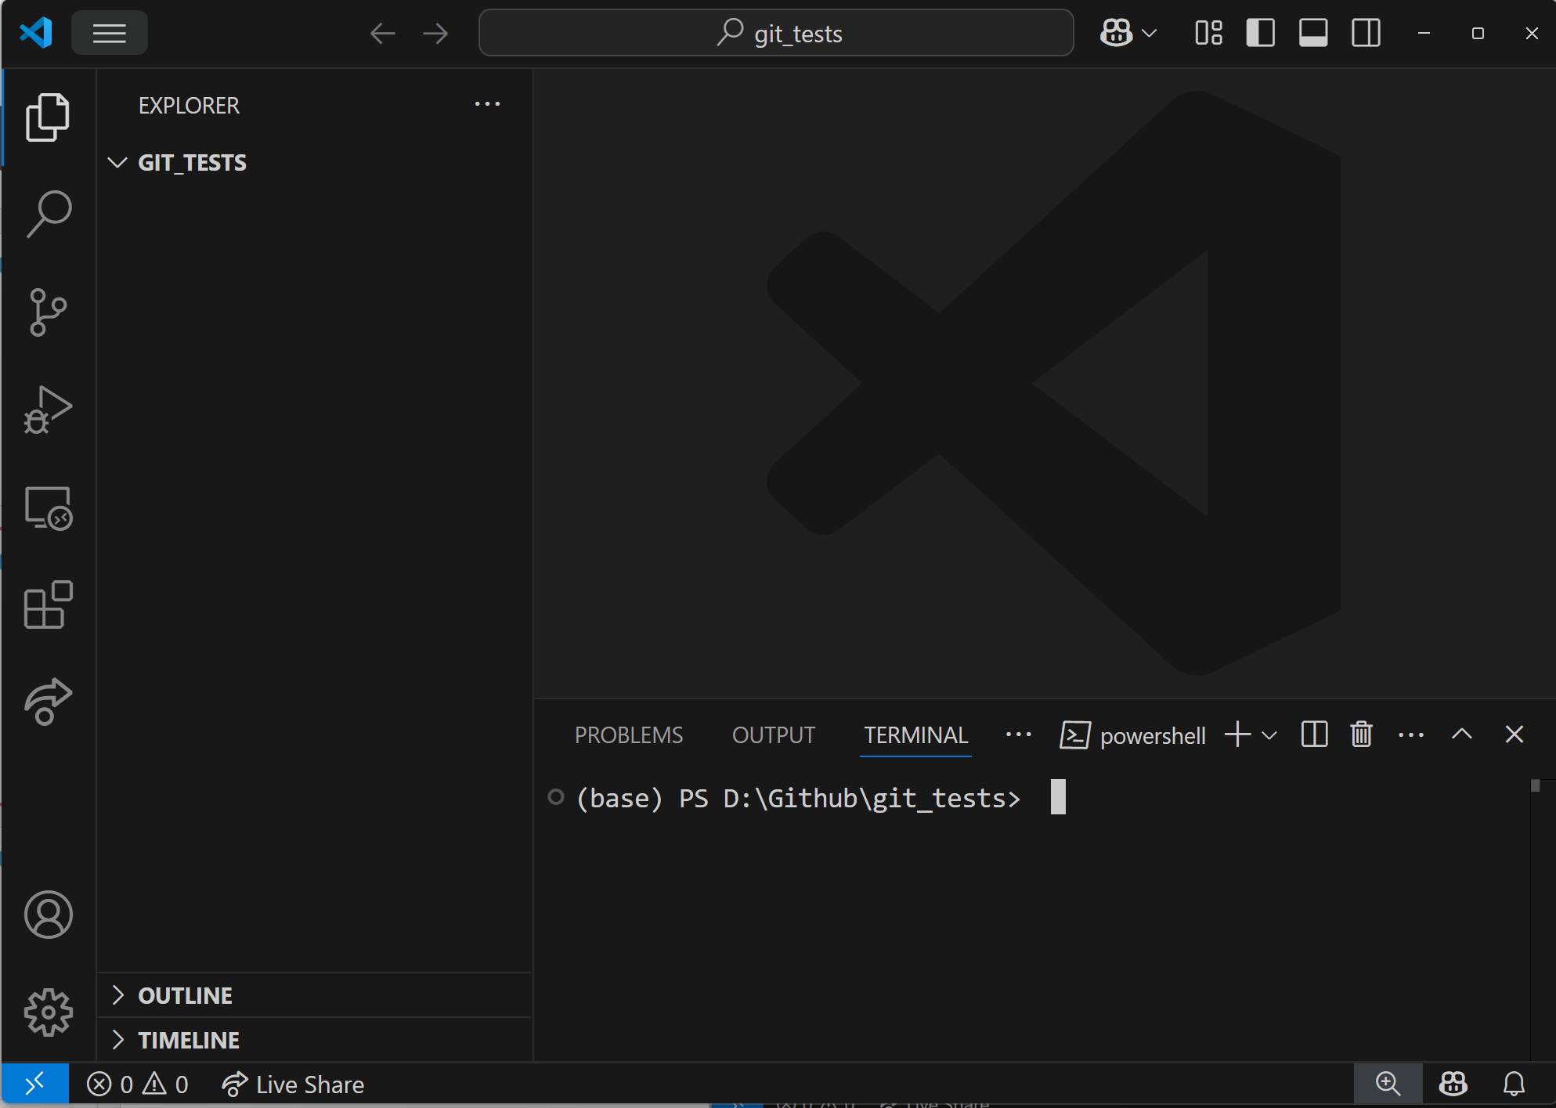
VSCode + Git

Slide 31
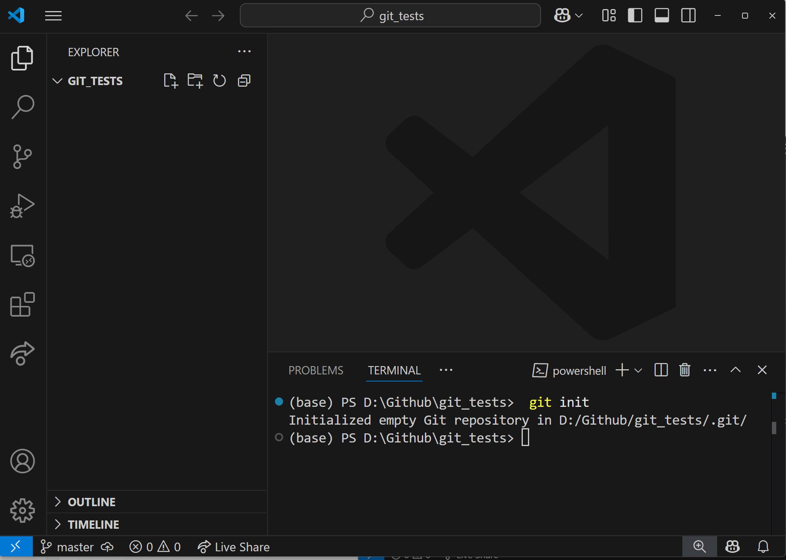
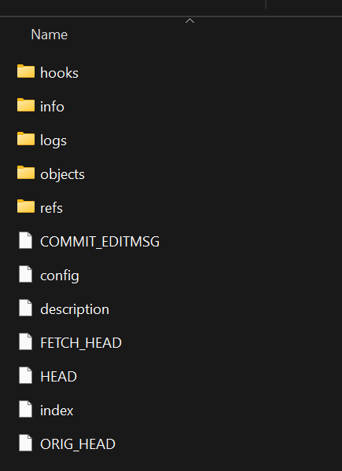
VSCode + Git

Slide 32
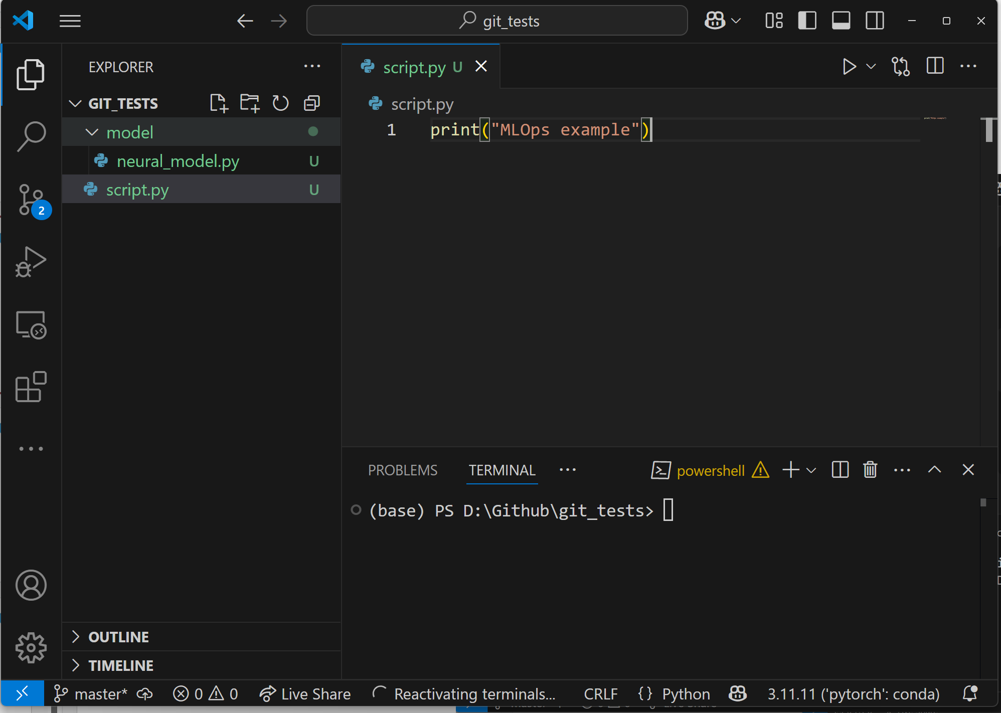
VSCode + Git

Slide 33
VSCode + Git
A - Added (This is a new file that has been added to the repository)
M - Modified (An existing file has been changed)
D - Deleted (a file has been deleted)
U - Untracked (The file is new or has been changed but has not been added to the repository yet)
--------------------------------------------------------------
C - Conflict (There is a conflict in the file)
R - Renamed (The file has been renamed)
S - Submodule (In repository exists another subrepository)
T - Typechange (The file changed from symlink to regular file, or visa versa)

Slide 34
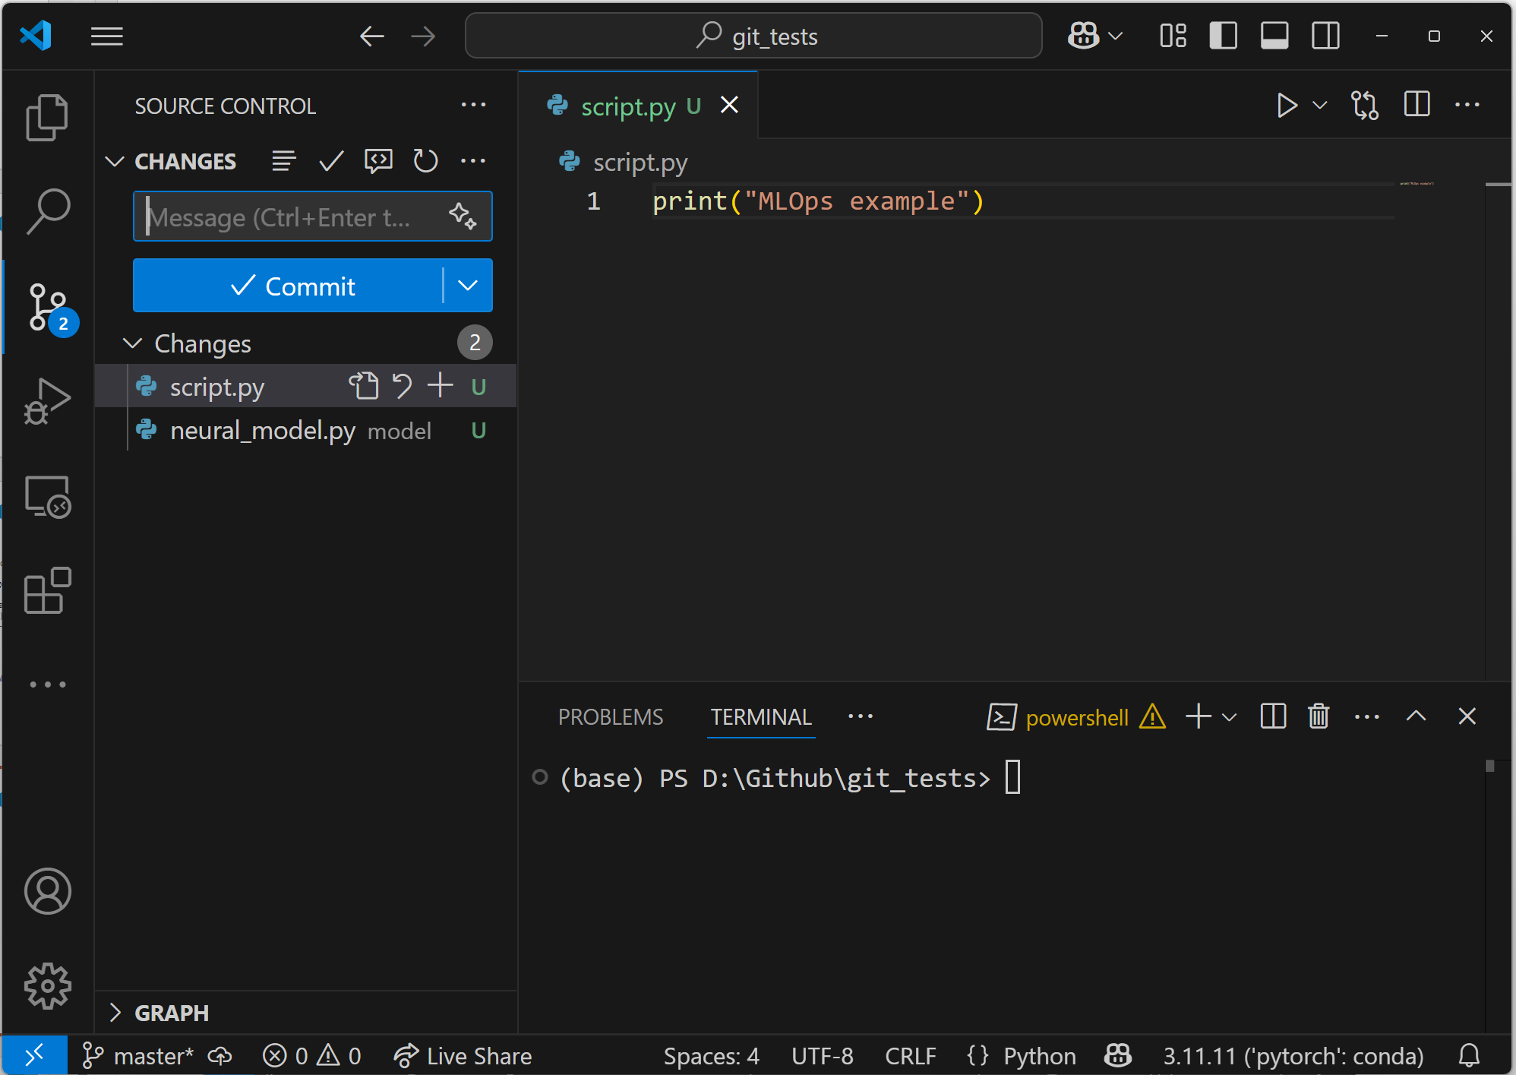
VSCode + Git

Slide 35
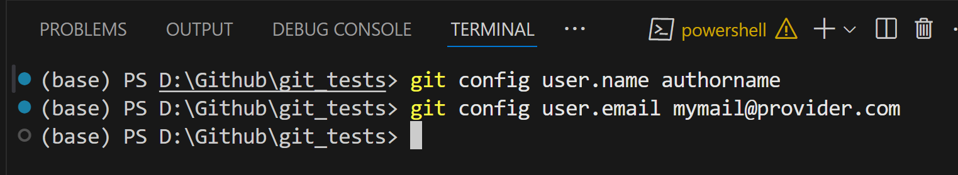
VSCode + Git

Slide 36
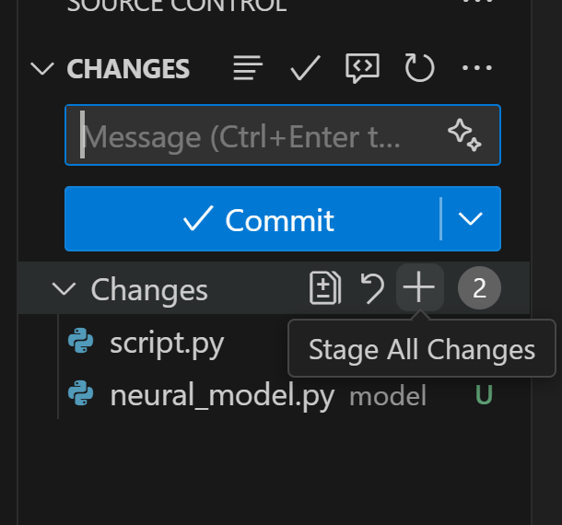
VSCode + Git

Slide 37
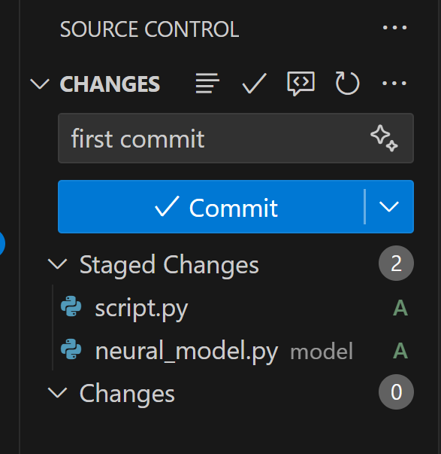
VSCode + Git

Slide 38
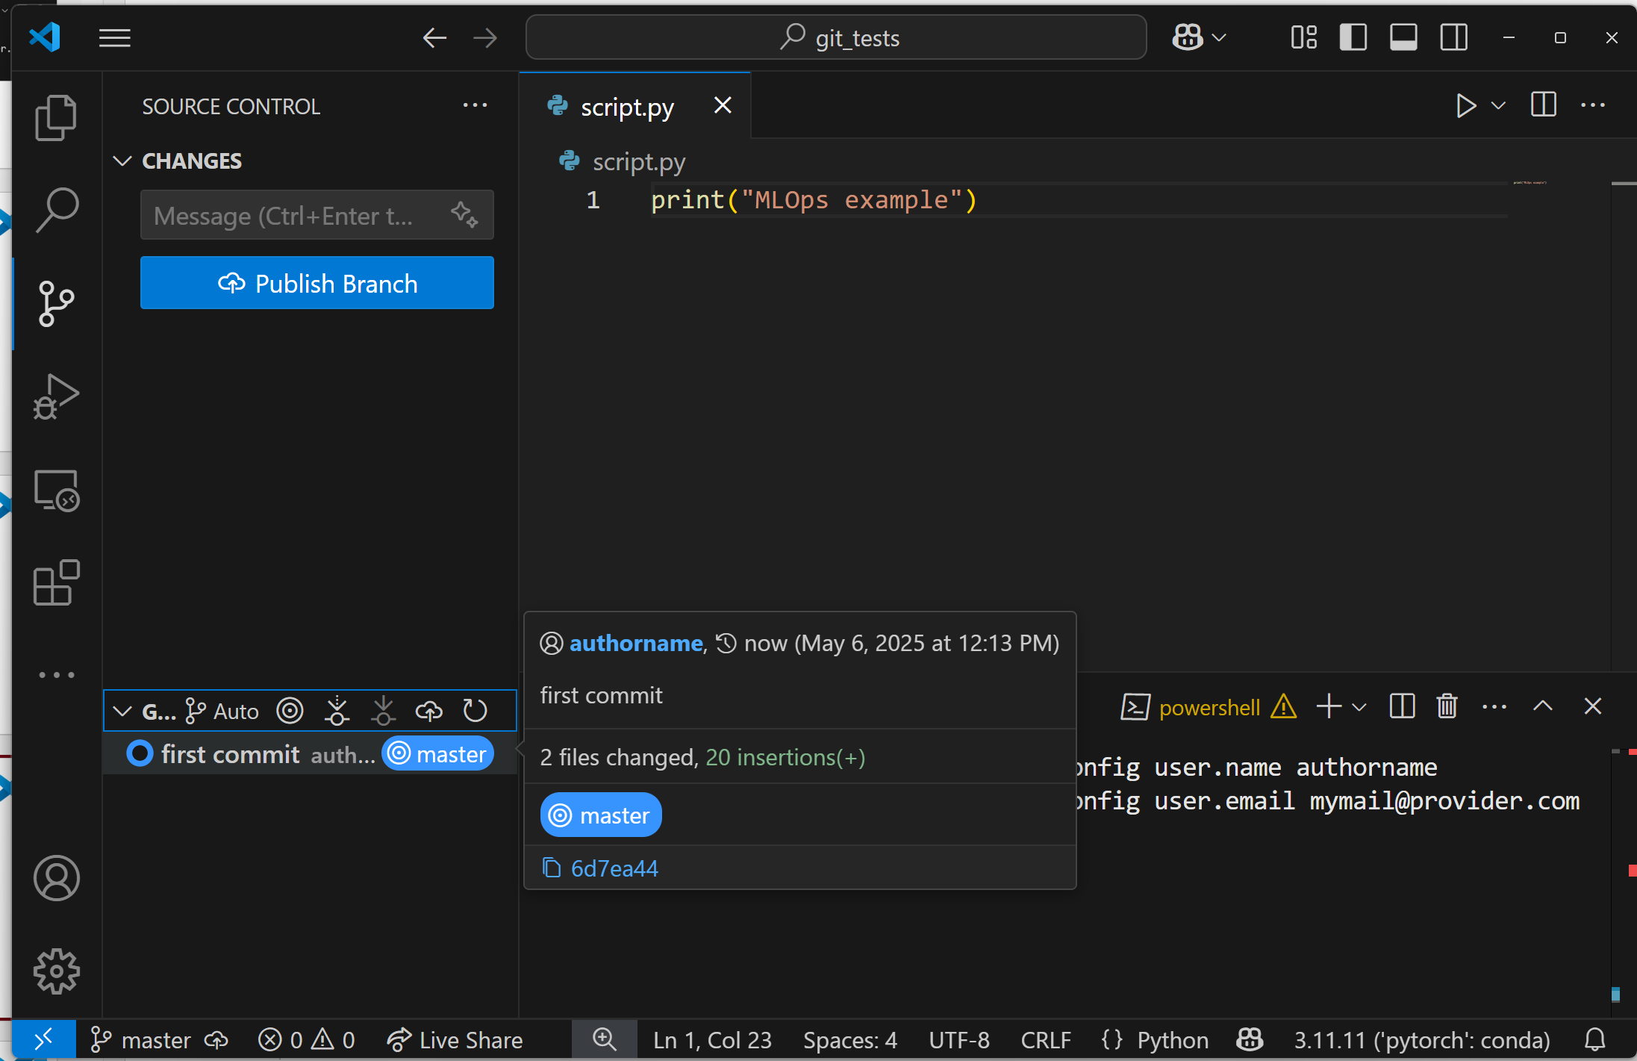
VSCode + Git

Slide 39
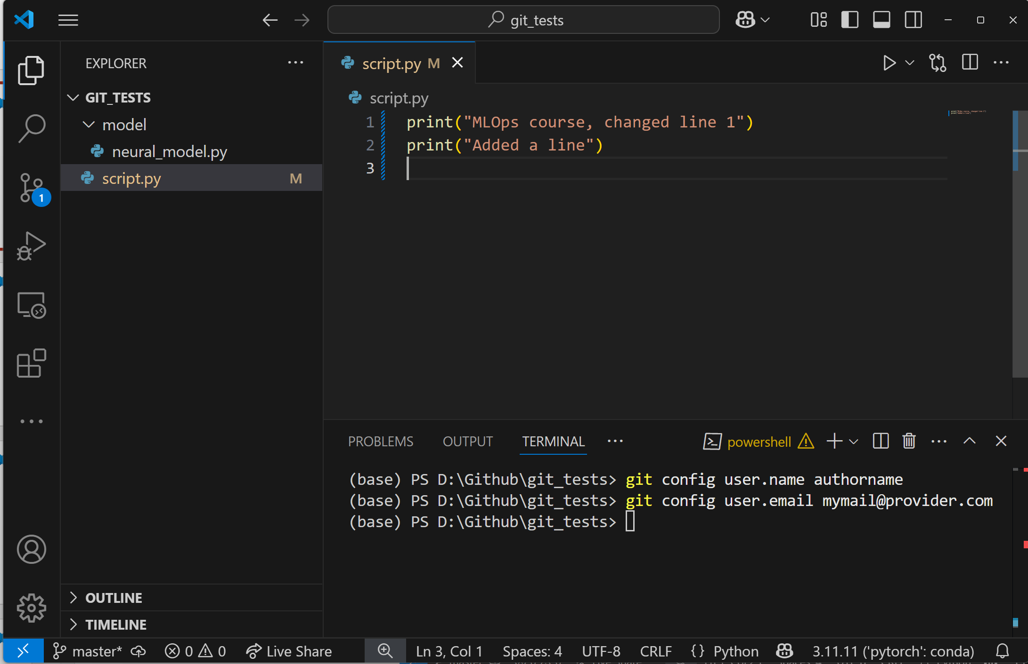
VSCode + Git

Slide 40
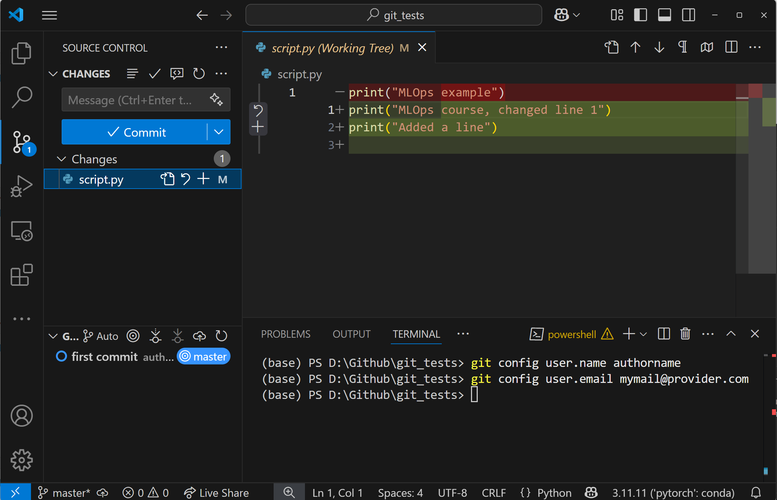
VSCode + Git

Slide 41
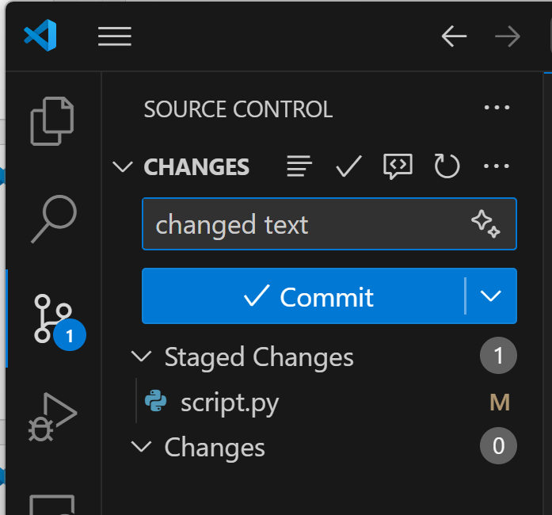
VSCode + Git

Slide 42
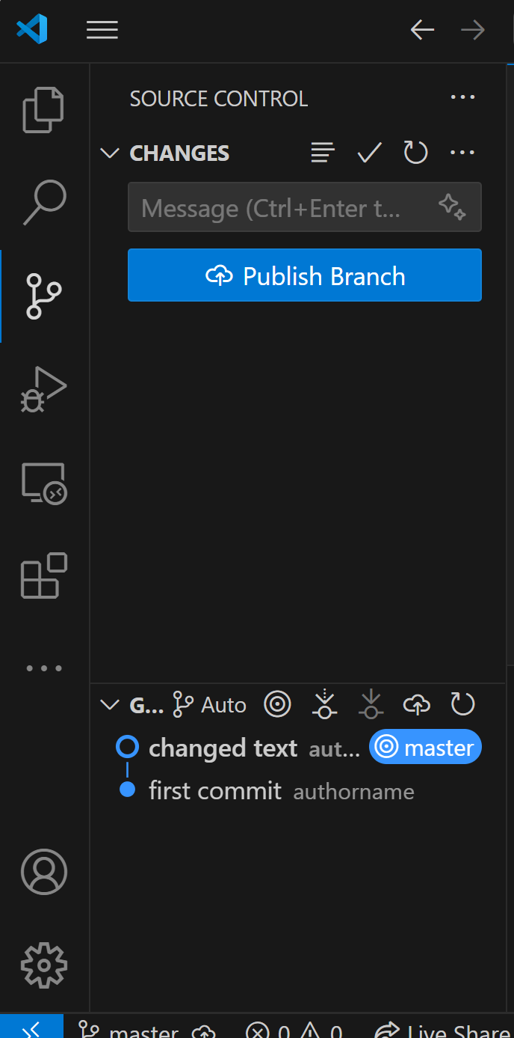
VSCode + Git

Slide 43
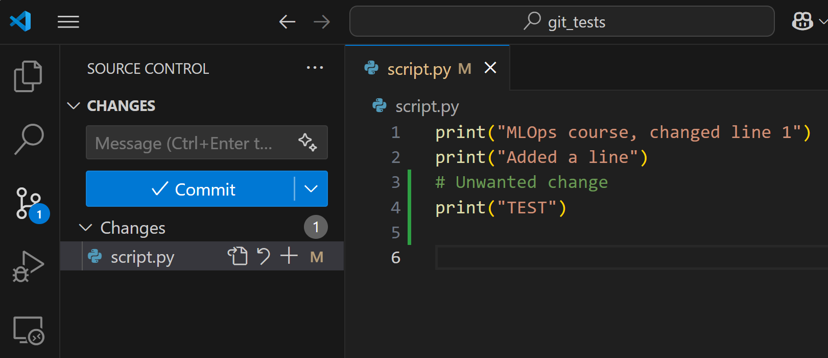
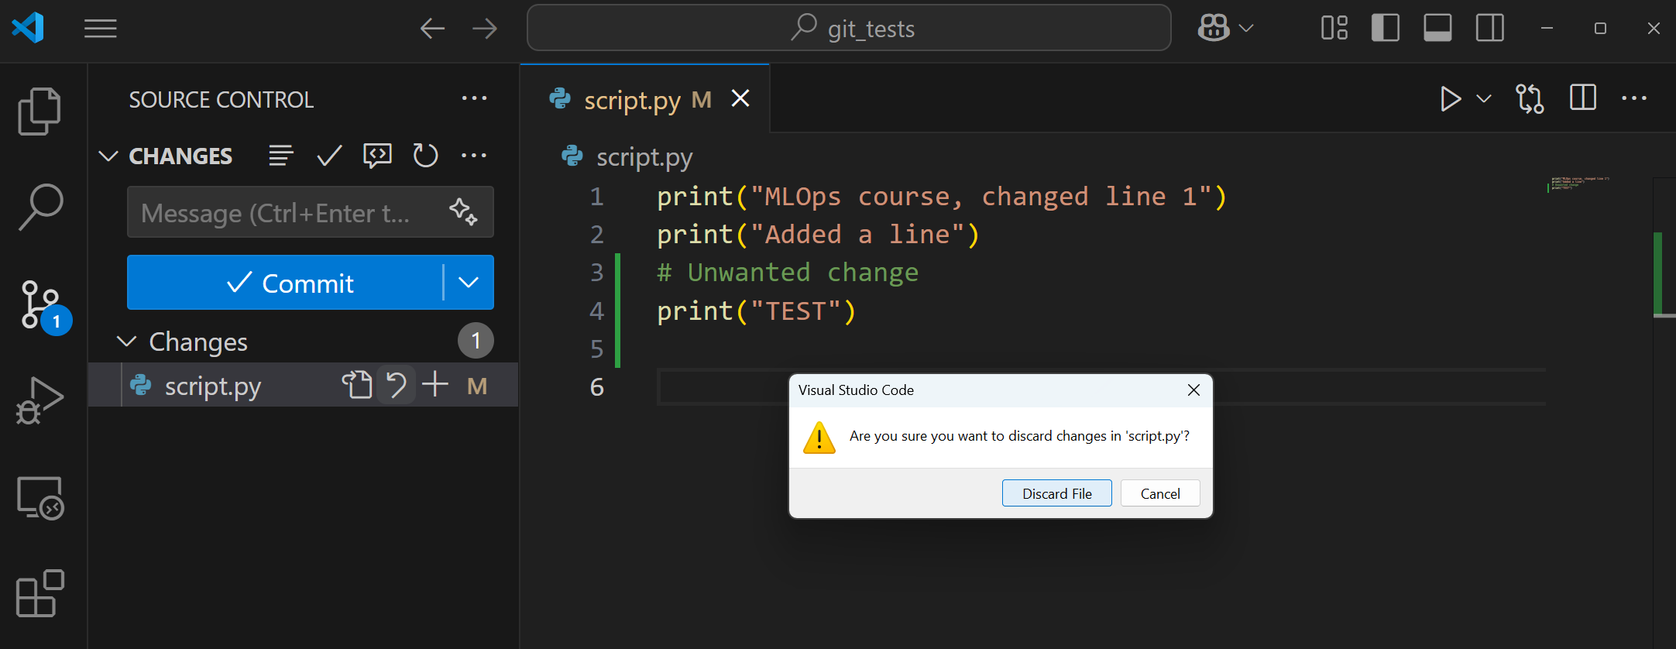
VSCode + Git

Slide 44

VSCode + Git - Collaboration
To do so, you need to use one of the popular hosting platforms that handles repositories.
For instance Github (it’s not the only one)
github.com

Slide 45
VSCode + Git - Collaboration
You can push directly from VSCode in a private or public branch.
Private Repository
Public Repository

Slide 46
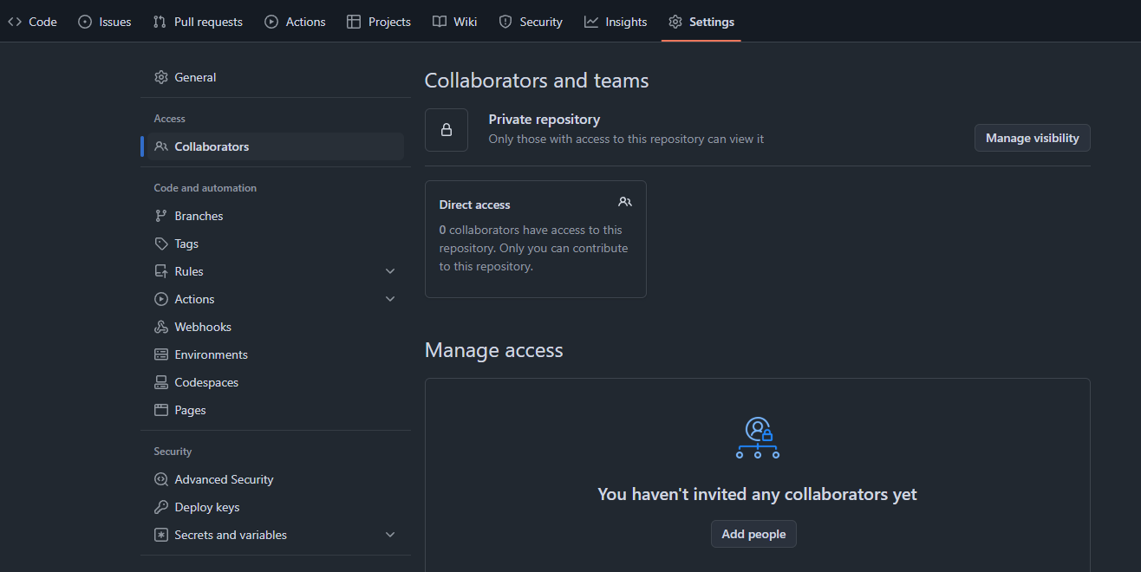
VSCode + Git

Slide 47
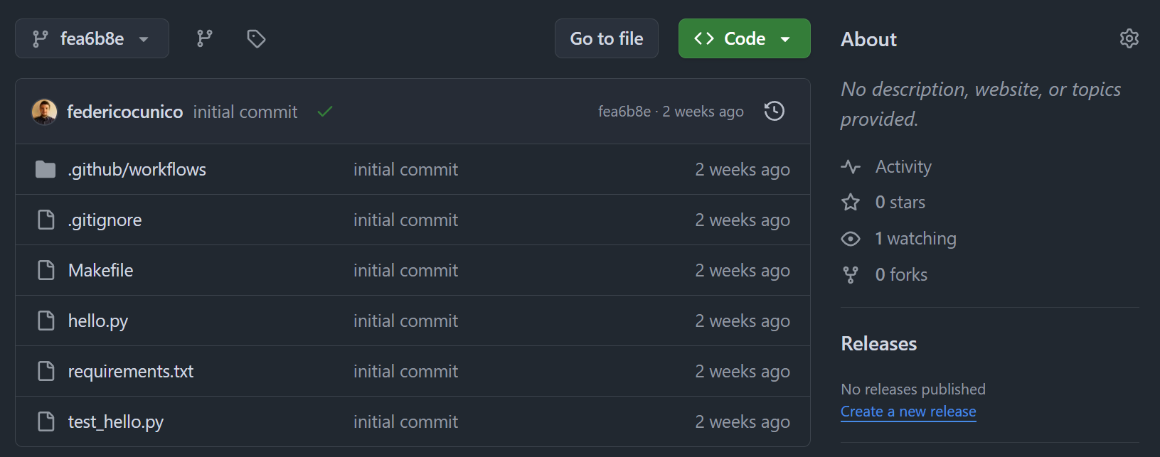

Slide 48
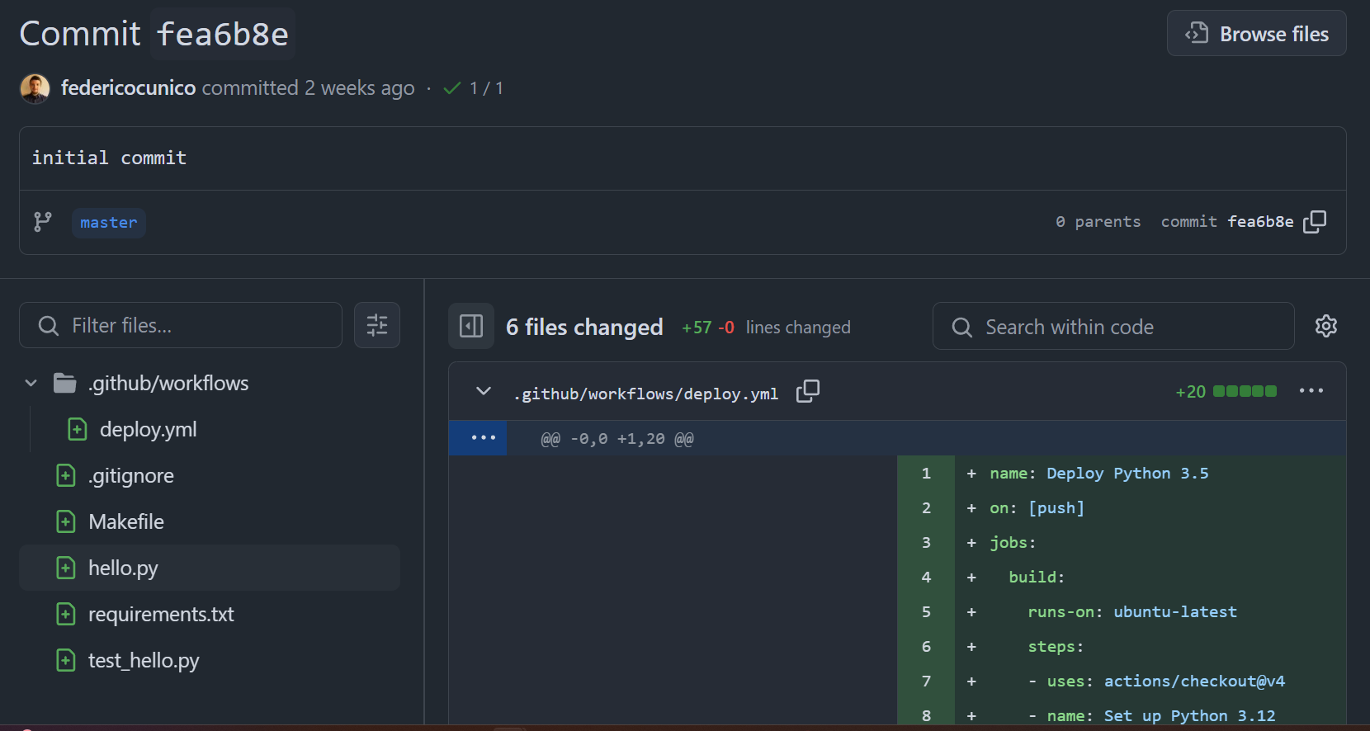

Slide 49

Branches
Branches are isolated sets of commits;
Allow to work on separate version of the code; see them as “alternative timelines”;
Ideally: a branch is a feature you want to implement in the project, a bugfix, a code refactoring, etc…

Slide 50

Merging
Is a way to “rejoin timelines”;
The merge can be painful to handle:
Automatic -> no overlap; the easy scenario
Nothing to do!
Manual -> manual merge is required, no automatic solution works
Edit the files with conflicts
Add again to staging area
Commit the change
Retry merge

Slide 51
Exercise
Try creating a git repository and publish on your own github account (university provides free Pro licenses);
Implement a simple algorithm of your choice;
Do at least 2 commits.
Verify github action results, make them always pass (not fail)
(optional) create a branch for a new feature (as for instance a new file) and merge the branches.

Slide 52
DevOps vs MLOps

Slide 53
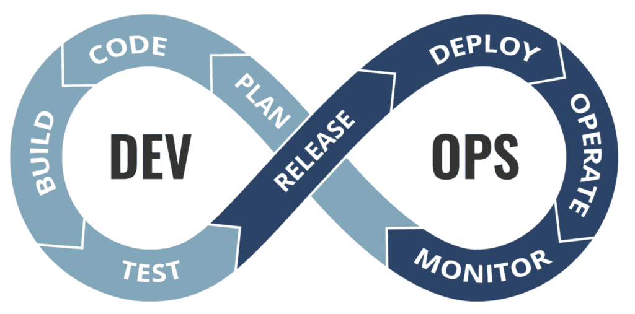
DevOps
Paradigm for enabling faster deploy of features and having a better end product;
In DevOps, there are two main parts:
Development (plan/code/build/test);
Ops (release/deploy/operate/monitor);

Slide 54
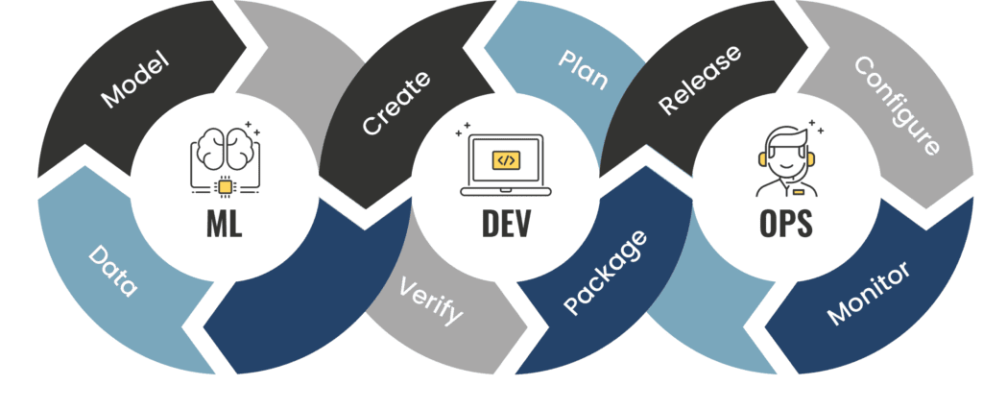
MLOps
Similar to DevOps, but different due to the issue of having two separate software entities:
The service;
The ML/DL model;
Conceptually similar, but with one more layer

Slide 55
DevOps vs MLOps
“Development” is different in the two concepts:
DevOps: code that creates application and it is wrapped in an executable (called “artifact”) that is validated against tests (unit/integration);
MLOps: there is the building/training of the machine learning model, and the artifact is the final model (usually heavy serialized file) that can be used for inference; Here the validation is against some test data (performance);

Slide 56
DevOps vs MLOps
Version Control:
DevOps: code and artifacts;
MLOps: same as above but also hyperparameters, metrics, data train/test splits, model artifact, etc…

Slide 57
Core processes and concepts
Continuous integration (CI):
Automated testing
Continuous delivery (CD):
Automated deploy
Microservices:
Software service with little to no dependencies
Infrastructure as Code (IaC):
Purely code defined environment for faster stack creation (e.g., Terraform)
Monitoring and instrumentation:
Helps making decisions about software performance and reliability

Slide 58
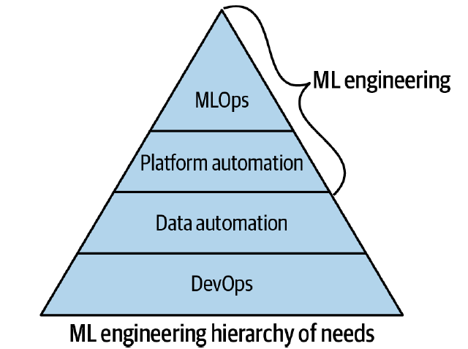
Shifting from DevOps to MLOps
Before diving into the ML part, it’s crucial to understand that DevOps is the core of all the process;
This in practice translates to the implementation of CI/CD.
Other processes are suggested, but depends on the situation.
Image from “Practical MLOps” by Noah Gift and Alfredo Deza, published by O’Reilly

Slide 59
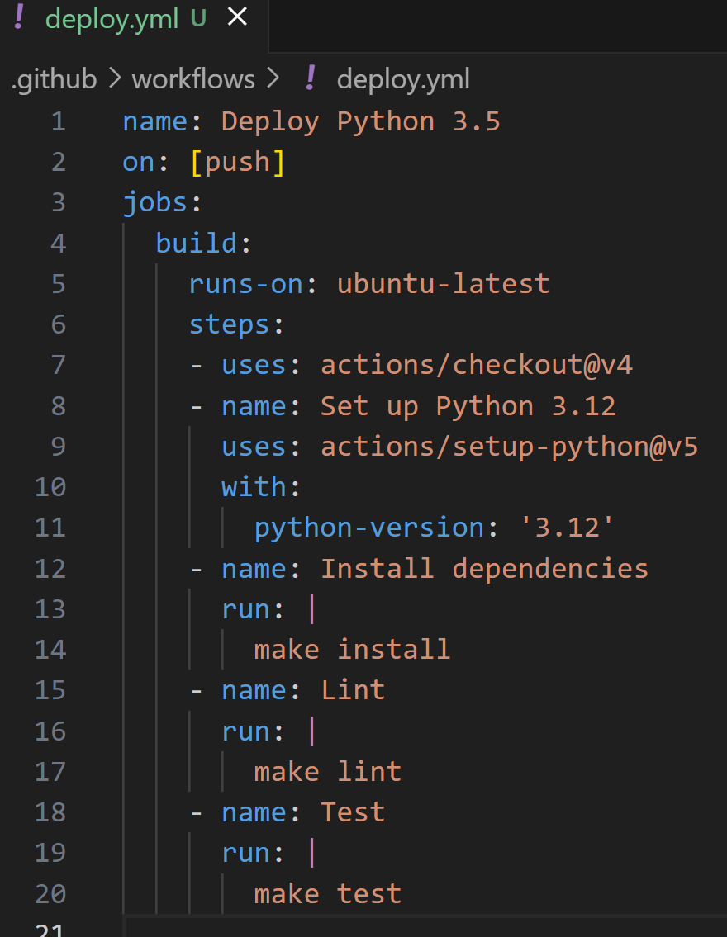
Continuous integration
Perform automation in testing:
Unit tests
Integration tests
For instance, performing lint tests, unit tests, dependencies, etc…

Slide 60
Continuous delivery
Kaizen emphasizes small, incremental changes that collectively lead to significant improvements over time.
Image from “Practical MLOps” by Noah Gift and Alfredo Deza, published by O’Reilly

Slide 61
MLOps
MLOps, in the end, extends DevOps with the concepts of ML;
This course is mainly oriented to ML concepts, giving some of the previously mentioned DevOps processes as acquired.

Slide 62
MLOps
In a very practical way, MLOps is essentially as the following feedback loop
Audit trail can be seen as “logging”, but not limited to that
Image from “Practical MLOps” by Noah Gift and Alfredo Deza, published by O’Reilly

Slide 63
MLOps
Final introductory note:

Slide 64
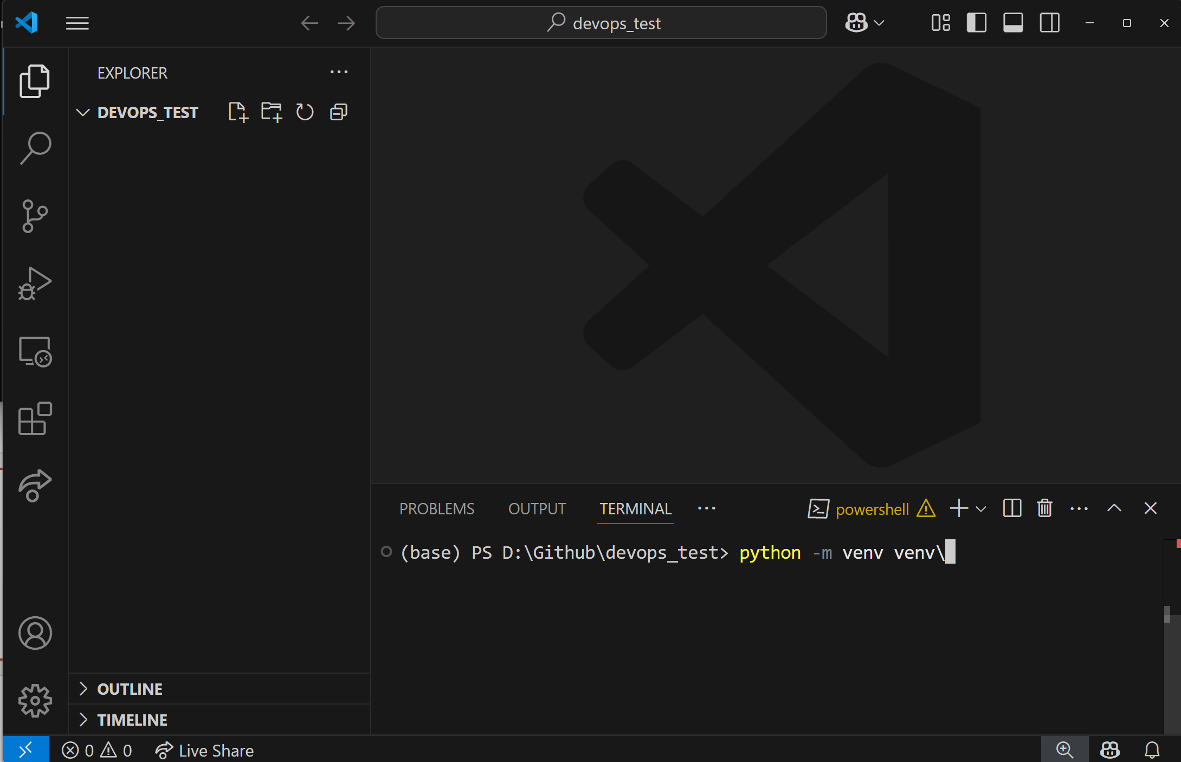
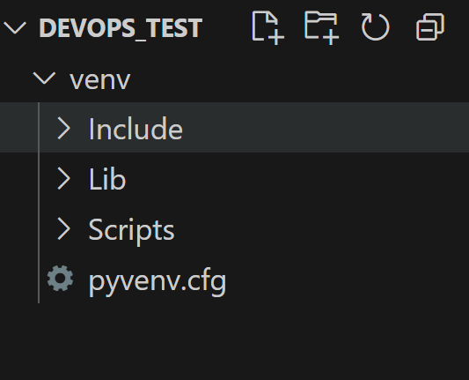
Example
First of all, install venv with

Slide 65
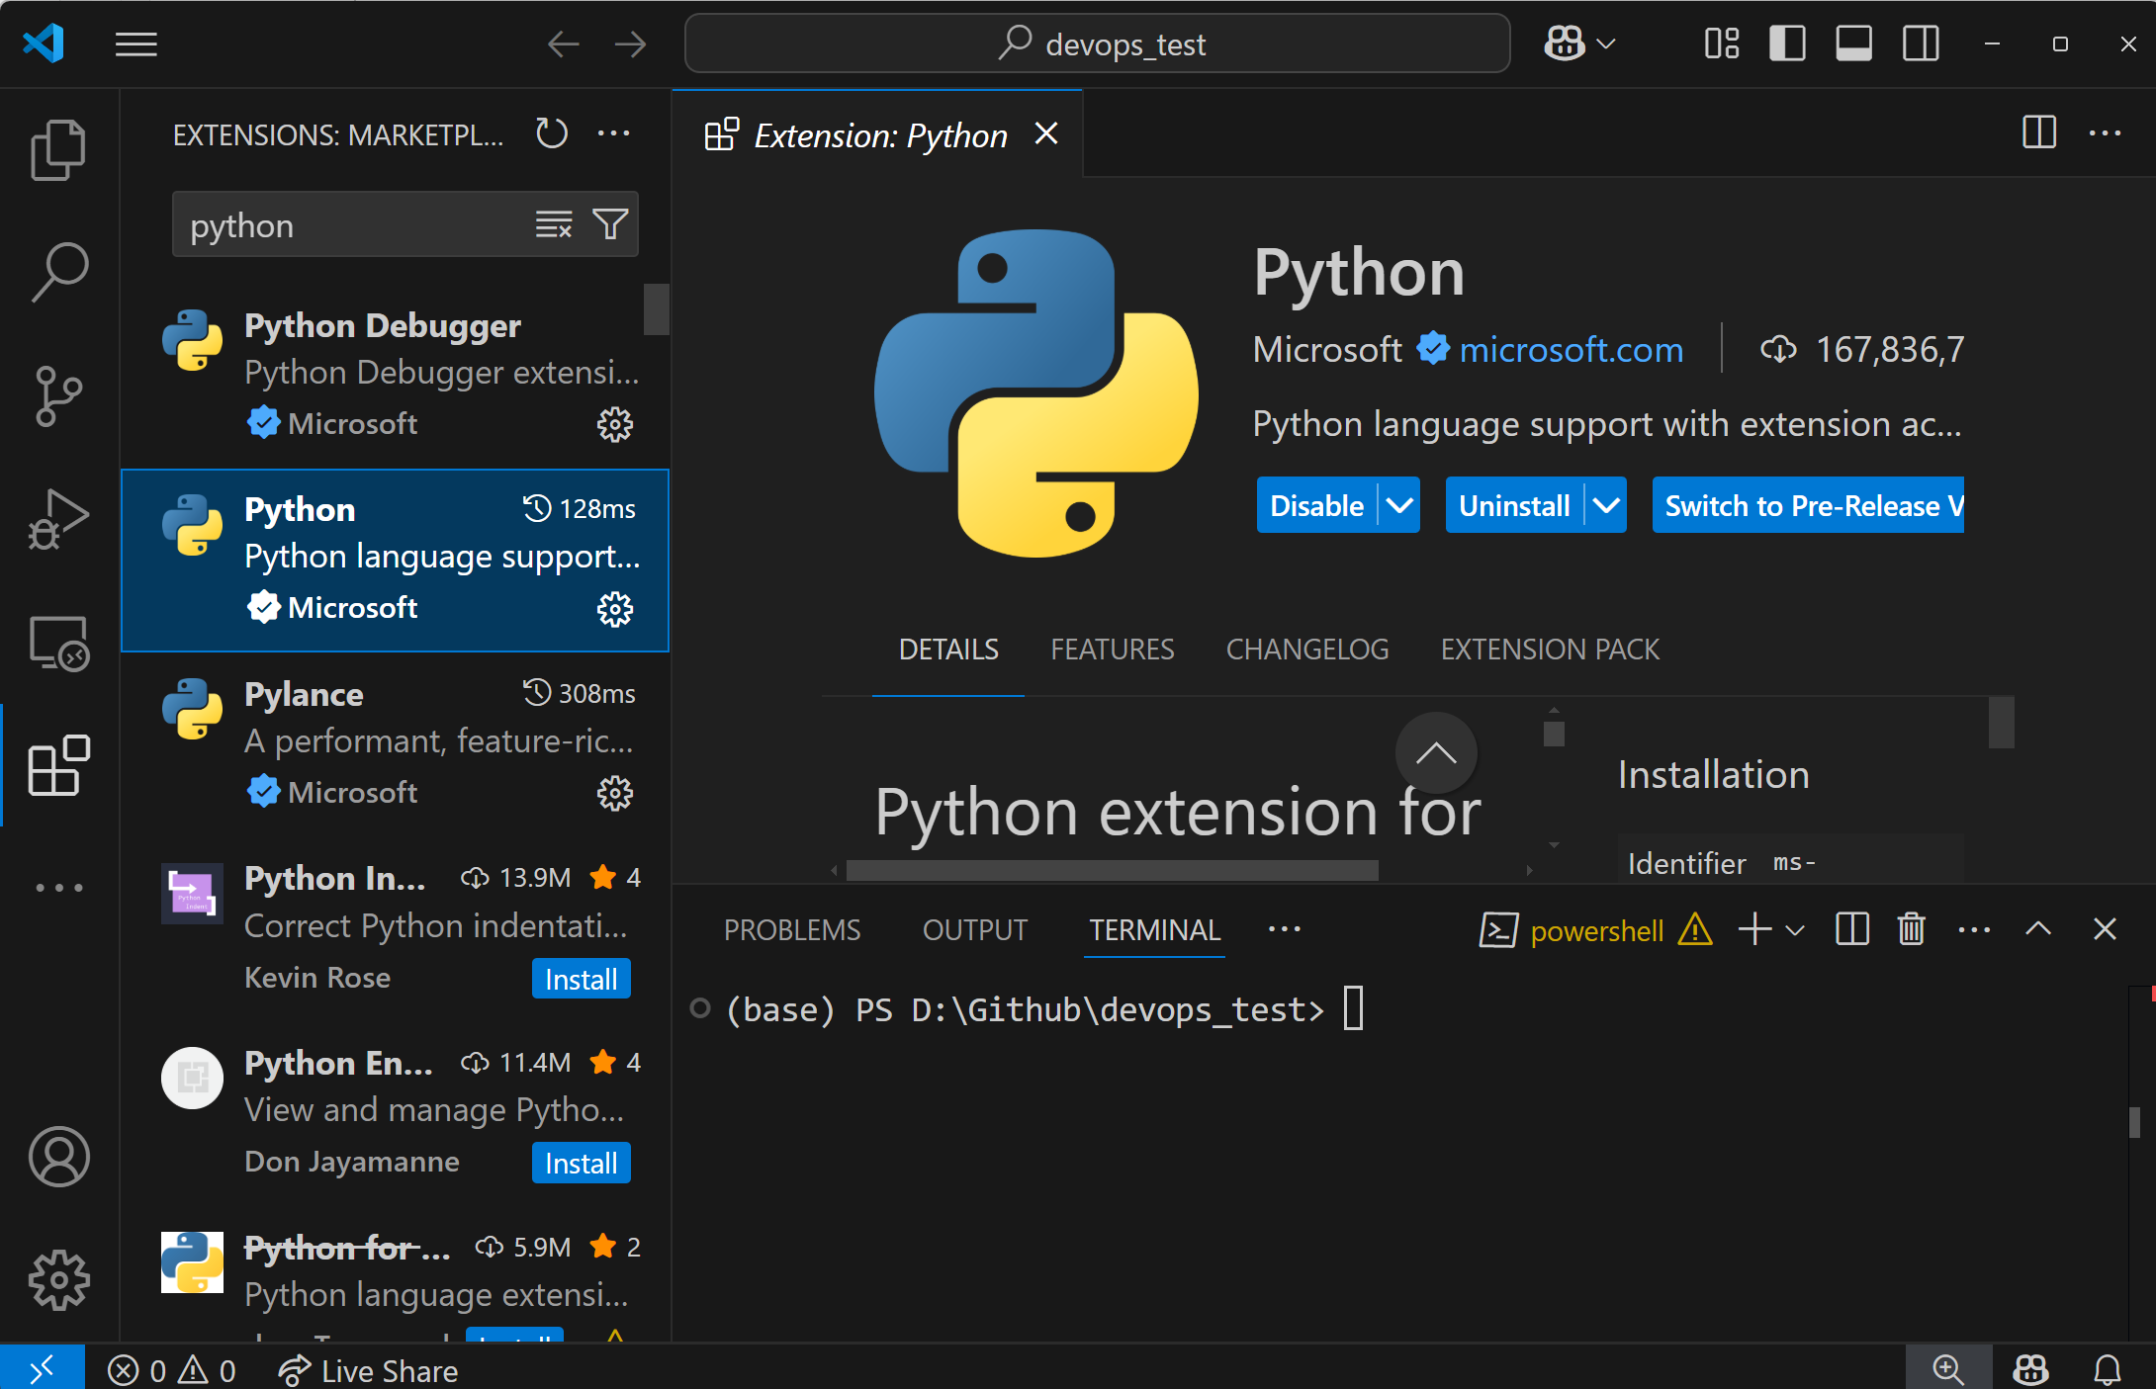

Slide 66
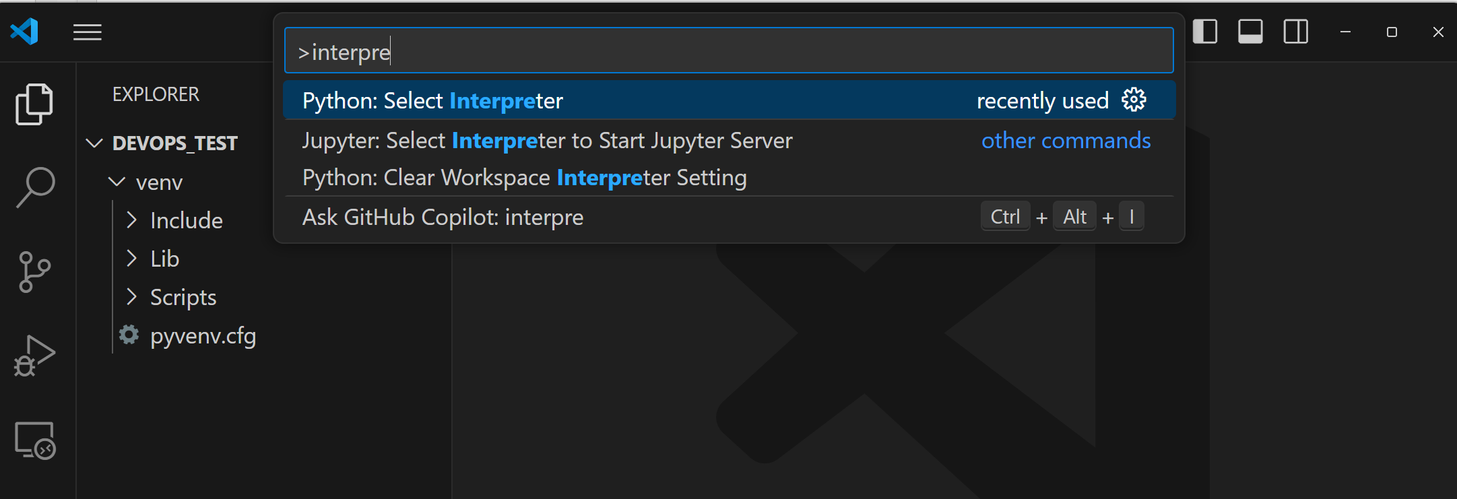

Slide 67
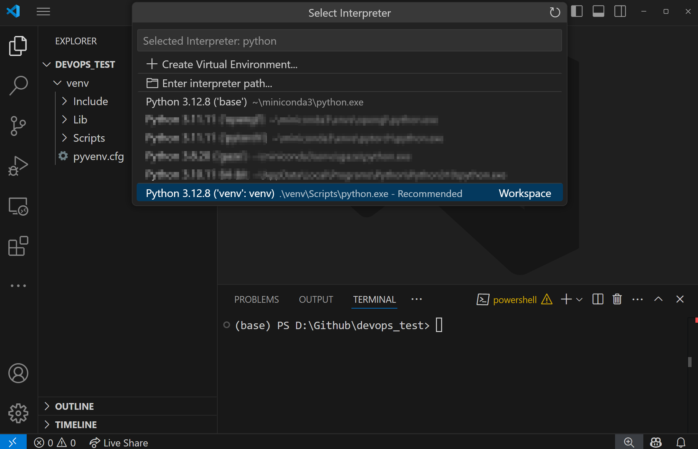
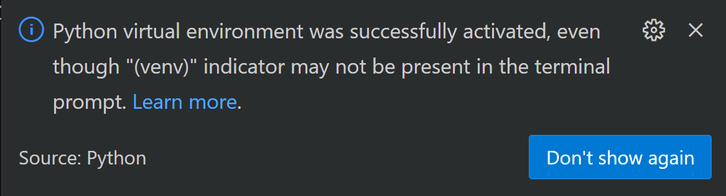

Slide 69
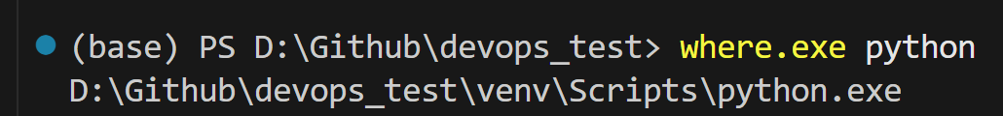
Correct environment?
In linux, the equivalent is “which”
Note: in command line you can use:
source ./venv/bin/activate for linux
.\venv\Scripts\Activate.ps1 for windows

Slide 70
Example (and python crash course)
Let’s define a github repo like:
MakeFile
requirements.txt
hello.py
test_hello.py
venv

Slide 71
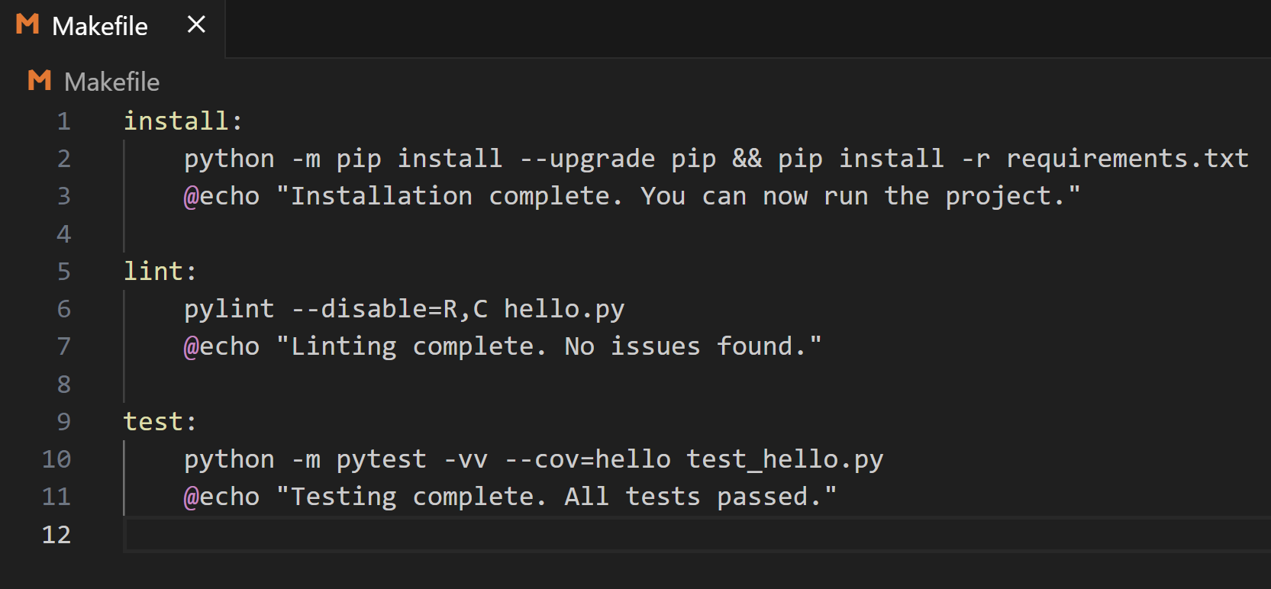

Slide 72
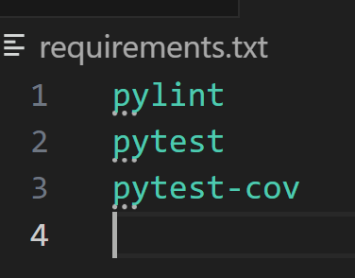
Requirements

Slide 73
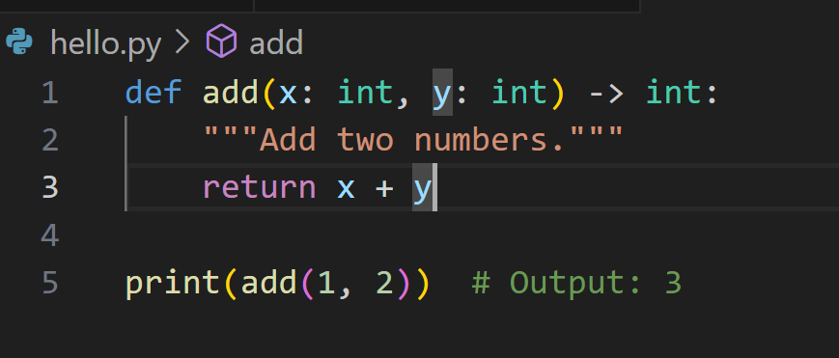
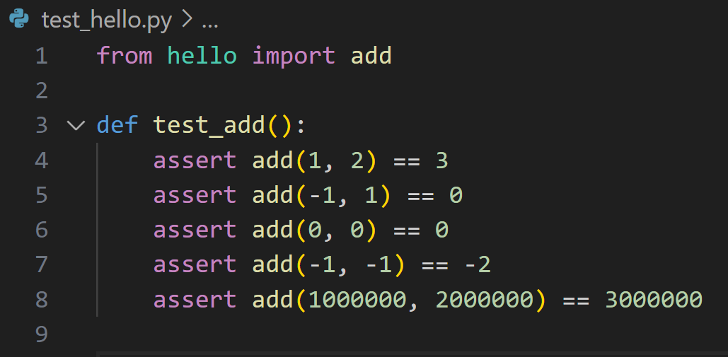
Test scripts

Slide 74
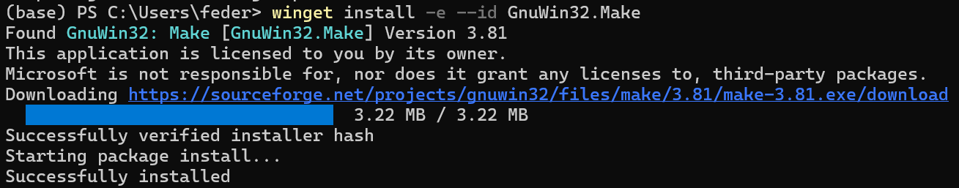
Run make file
On linux:
sudo apt update && sudo apt install make
On Windows (many ways):
winget install -e --id GnuWin32.Make
Or:
choco install make

Slide 75
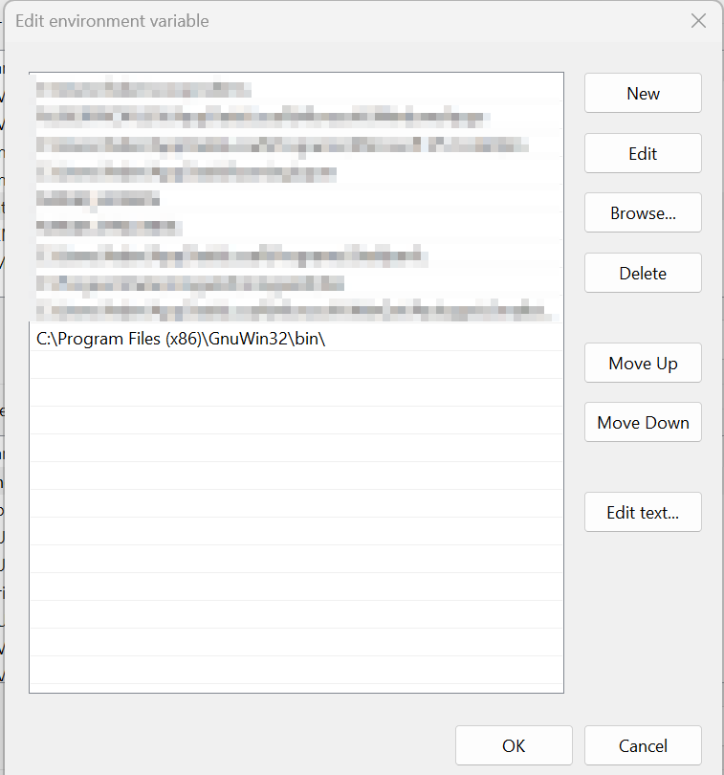
Remember to add to env variables, if on windows…

Slide 76
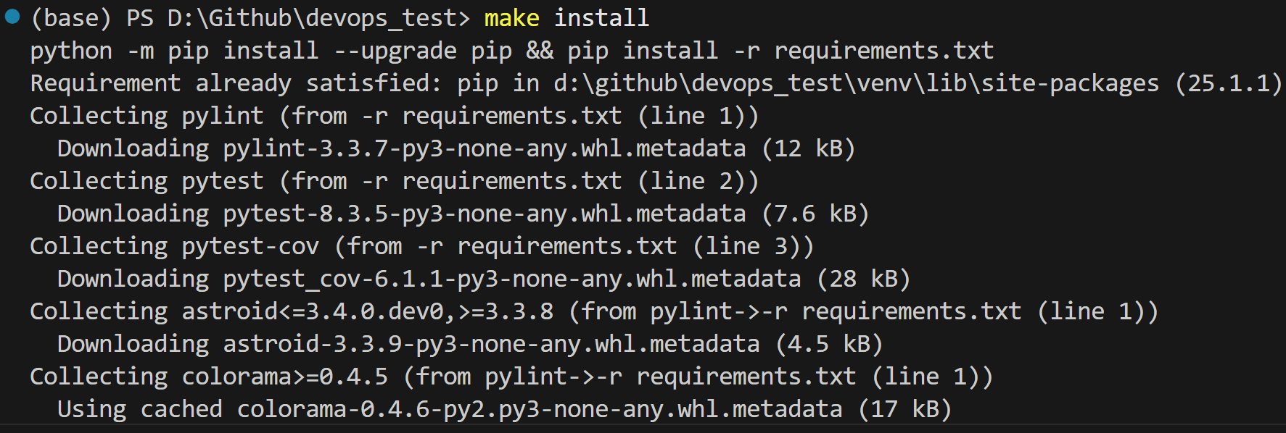
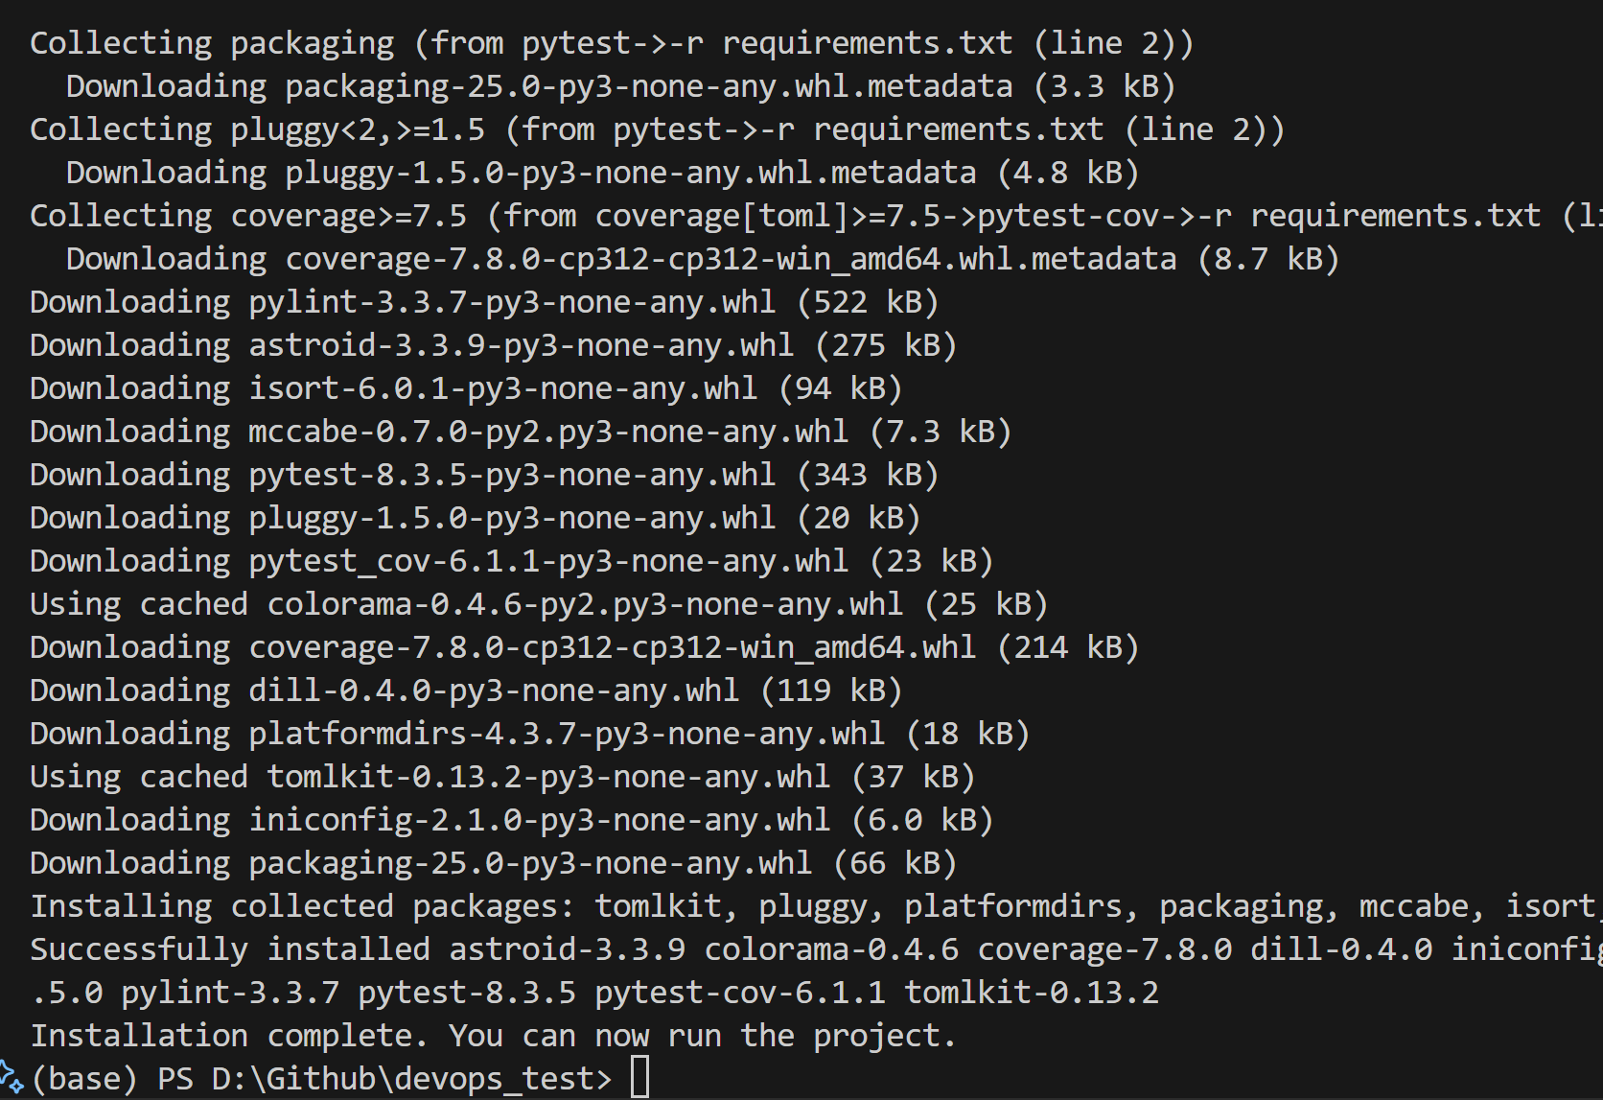

Slide 77
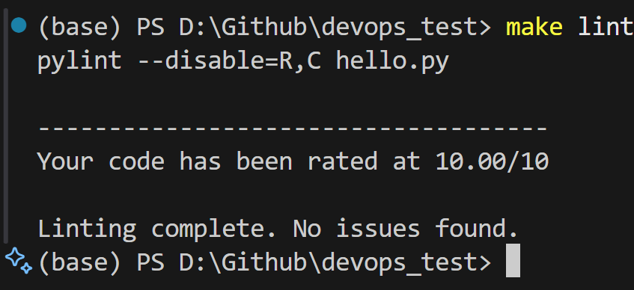

Slide 78


Slide 79



Slide 81


Slide 82


Slide 83


Slide 84


